Slide 1

Welcome To Local Bartending School
http://localbartendingschool.com/

Slide 2

About
LBS(Local Bartending School) is a bartending school providing certification throughout all 50 states online and in-person in North america. We have talented, certified teachers and an online platform for remote learning.We offer certifications in 42 of 50 states, over 1000 certified bartending trainers. LBS teaches bartending classes, lessons, and online courses. It offers state certification and job placement.
We are able to give you such close attention because our certification courses come to you. It's a customized, one-on-one, expedited course. We bring the pourers, bar supplies, shot glasses, everything... right to your kitchen. With over 1300 instructors, nationwide, we offer convenient, customized, and low cost courses.

Slide 3
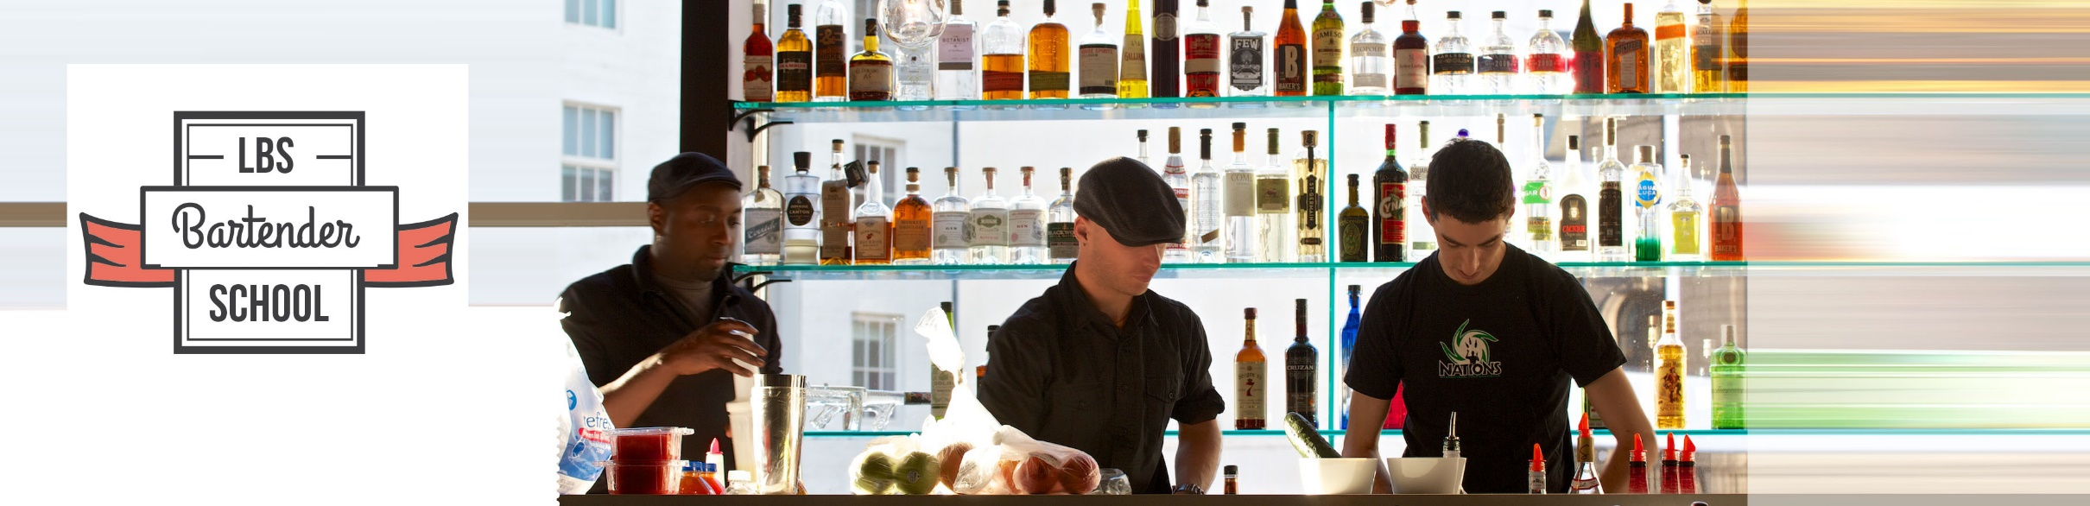
LBS Bartending Class
Bartending School was organized to help teach people of all levels. We will teach you the principles of bartending like tips, wines, liquors, beers, and over 200 mixed drinks. This is an all-inclusive series on everything from beginner bartending to more complex bartending.
We can come to your home or teach at one of our multiple locations. The exact location depends on which day and time you choose and what level of instruction you need.

Slide 4
LBS Program
LocalBartendingSchool.com offers the convenience of scheduling a lesson whenever you want them. LocalBartendingSchool.com offers lower prices that save 20-60%.LBS is one of the few schools that offer creative financing solutions to students with satisfactory credit.
Compare Our Program
Mix and Pour Course - $329 and up | LocalBartendingSchool.com -$229 | Save $100
State Certification Course - $499 and up | LocalBartendingSchool.com - $329 | Save $150
State and TIPS Certification Course- $600 and up | LocalBartendingSchool.com - $399 | Save $200

Slide 5

In-Home Bartending Course
Full-certification is available in your home! Use all of the tools of a bar, in the comfort and convenience of your own. Get Certified at home and become a bartender. We bring the bar to you!
Our instructors travel to your home. It is the same price as our classes.

Slide 6
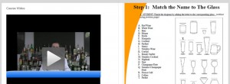
Online Bartending Course
Our online course is designed to give you all of the training and testing as our in-person classes. It is the perfect match for someone with a busy schedule! Receive full-certification on our online bartending course and state-authorized testing. Within 8 hours, you can earn your certificate.
We offer online certification - State Certification & TIPS Certification and online tutorial to give you all of the training and testing as our in-person classes.

Slide 7
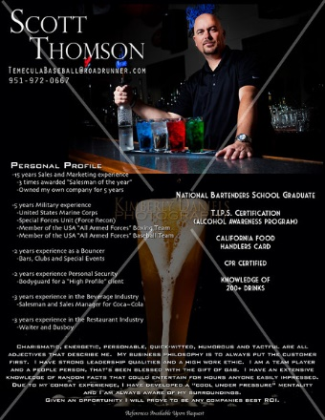
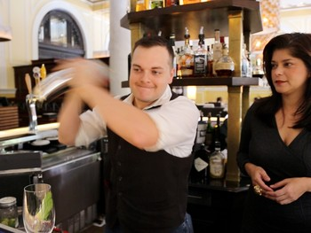
Job Placement
Local Bartending School's job placement program connects you employers and recruiters to help you find a bartending career.
Our job placement program includes:
An intensive session with up to three revisions with out resume experts. Convert your resume to up to three formats
A Clean, Professional Bartending Resume Template (a $19 value)
Your Own Professional Website! (www.localbartendingschool.com/your-name)

Slide 8
Contact Us
Contact Person: Rob Dunfey
Business Name: Local Bartending School
Service Area : USA
Opening Hours: 9 am-5 pm Monday-Friday 10 am-4 pm Saturday Closed: Sunday
Phone: (877)-447-4745

Slide 9
Thank
You!!...

