Slide 1
“BARTENDING WORK-SHOP”

Slide 2
Bar Equipments
Minor (Movable)
Major (Fixed)

Slide 3
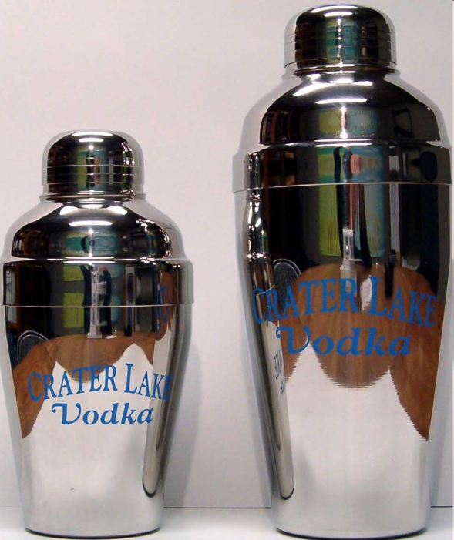
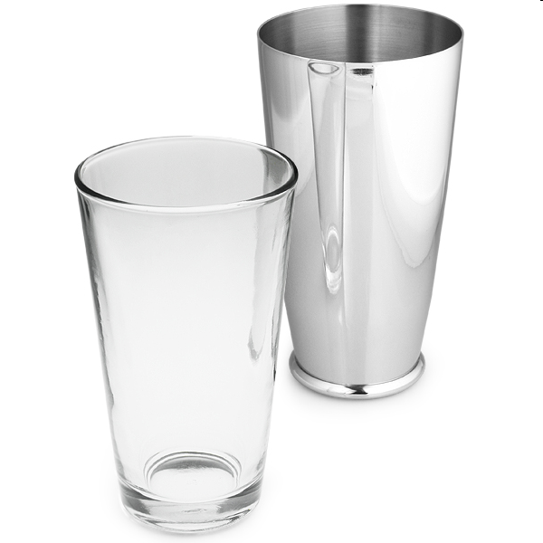
Cocktail Shaker
Boston shaker
Hawaiian/3 piece shaker

Slide 4
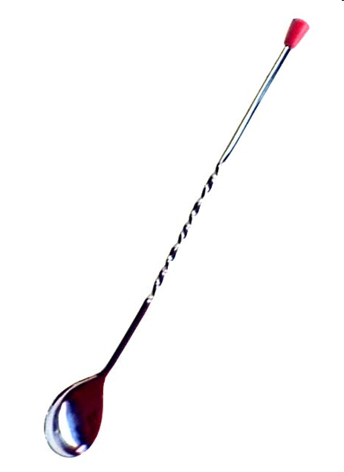
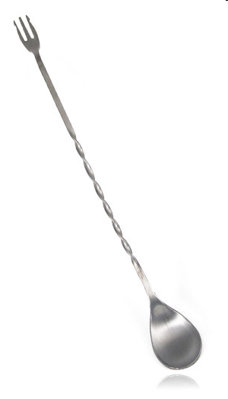
Bar Spoon
Used for stirring, floating, muddling & tasting Cocktails

Slide 5
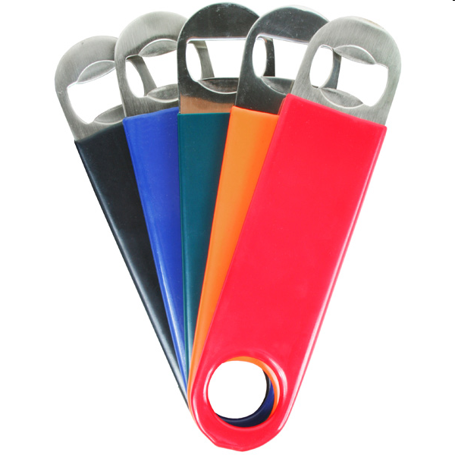
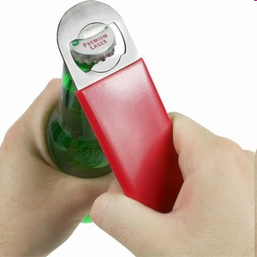
Bar Blade/Bottle Opener
Used to open bottle caps, also used by flair bartenders to open in style and finesse.

Slide 6
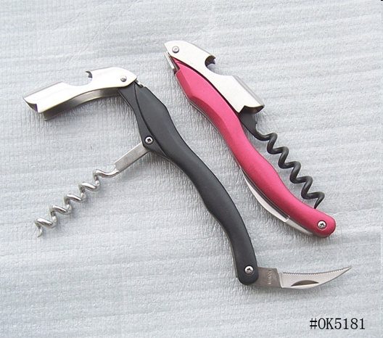
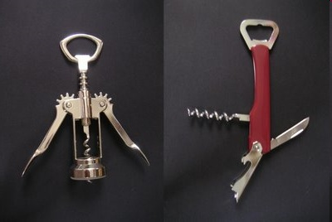
Wine Openers
Used to open wine bottles also known as Waiters friend.

Slide 7
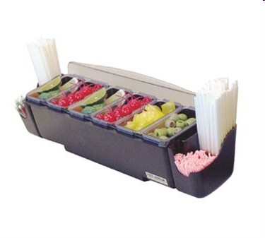
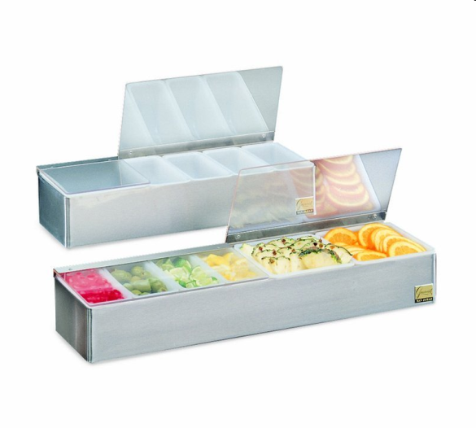
Garnish Tray/Condiment Holder
Used to hold garnishes for the cocktails

Slide 8
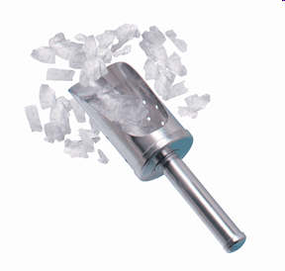
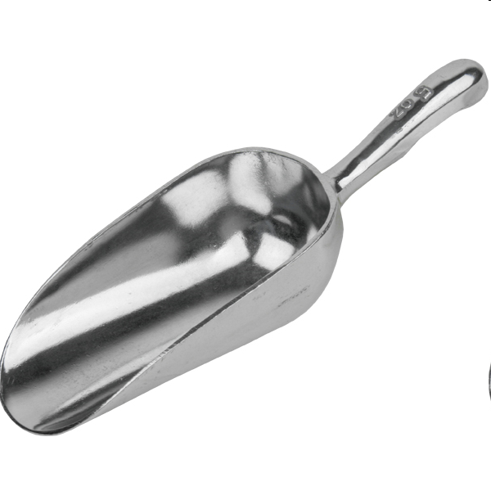
Ice Scoop
Used to scoop ice from the ice well

Slide 9
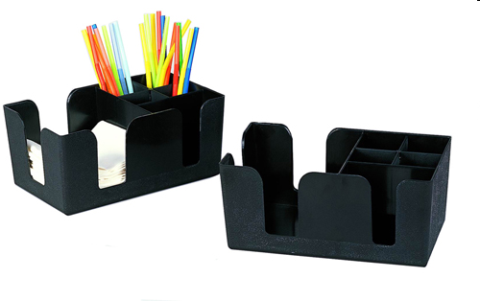
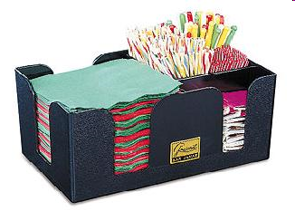
Bar Caddy
Used to keep bar accessories like……
Straws, stirrers, toothpicks, napkins, coasters etc.

Slide 10
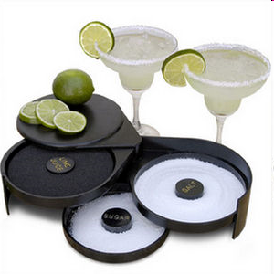
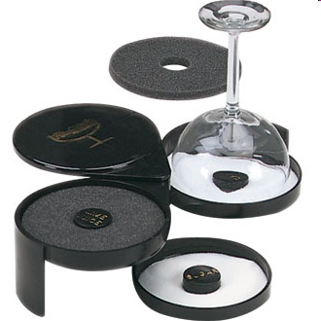
Glass Rimmer
Used for rimming of glassware before cocktail preparation

Slide 11
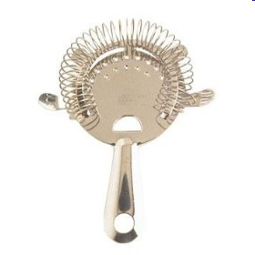
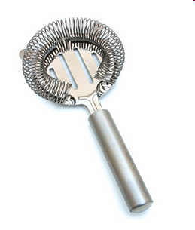
Hawthorne Strainer
Used to strain cocktails

Slide 12
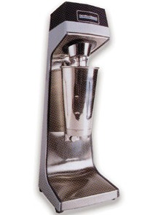
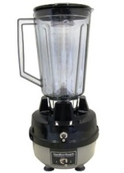
Mixer/Blender
Single spindle mixer Hamilton blender
Mixing drinks Blending drinks
Drinks: Punches, juice based Drinks: Frozen, fresh fruits based
Cream based etc

Slide 13
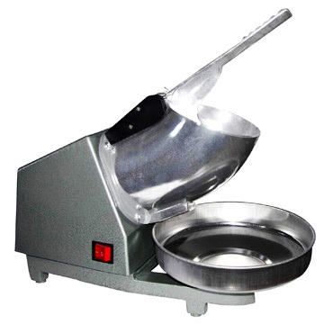
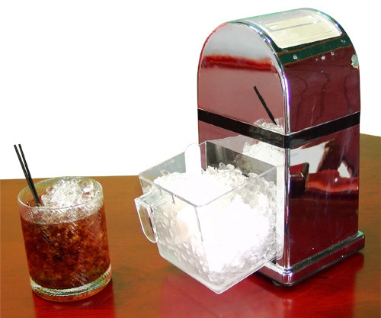
Ice Crusher
Electric ice crusher Manual ice crusher

Slide 14
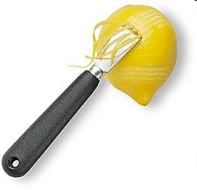
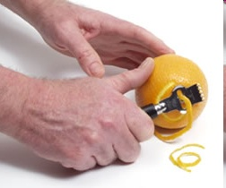
Zester
Used to peel zest from fruits & vegetables

Slide 15
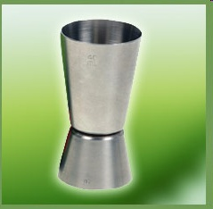
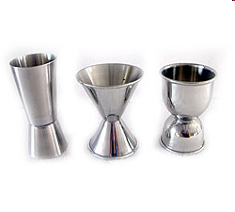
Peg Measurer
Used to measure alcohol for cocktails/drinks

Slide 16
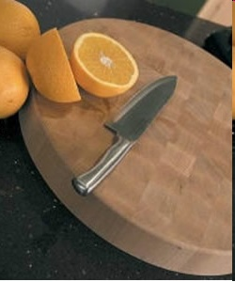
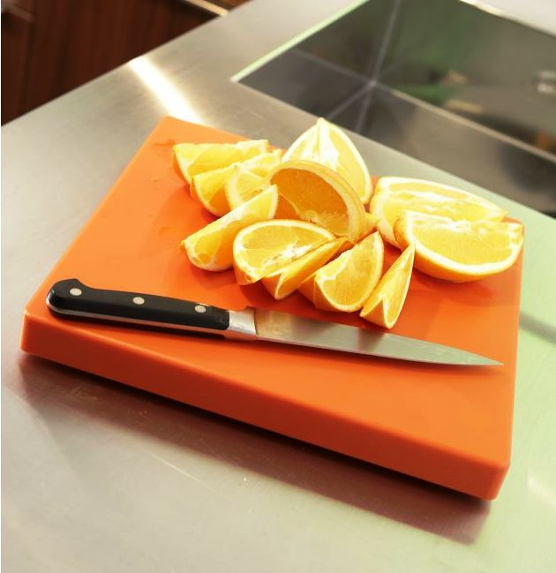
Chopping Board & Knife
Used to cut fruits & vegetables

Slide 17
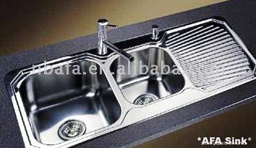
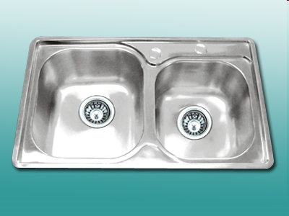
Major Equipments SS Sinks
Wash Basins & Ice well

Slide 18
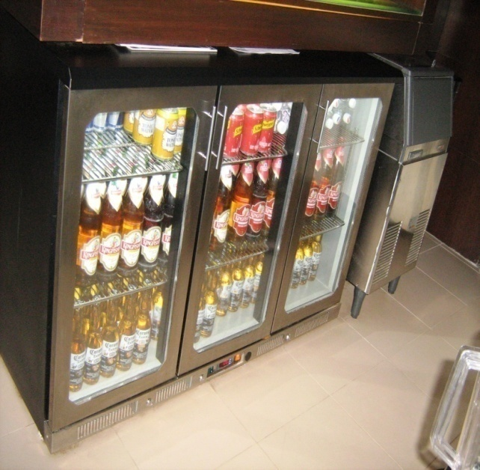
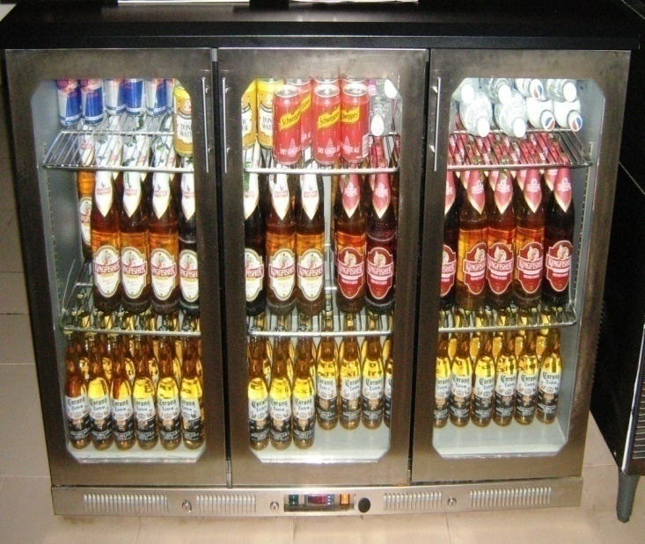
Bottle/Vizzy Cooler
Used for…….
Storage
Chilling
Visual selling

Slide 19
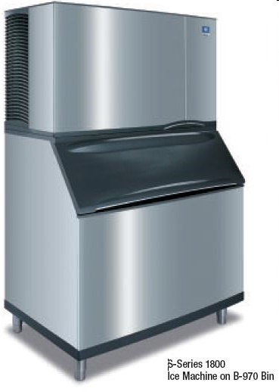
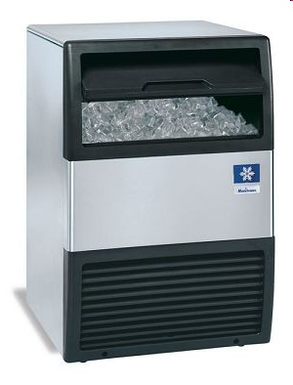
Ice Machine
Making Ice
Bullets
Cubes

Slide 20
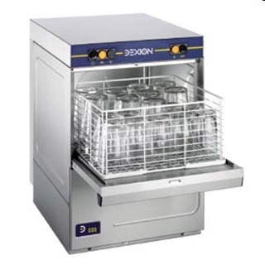
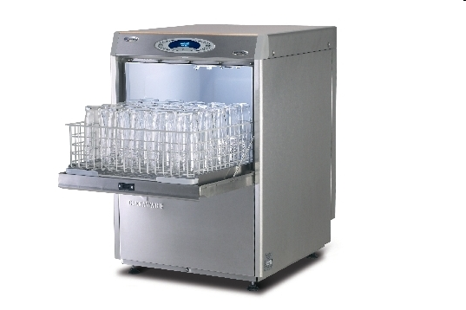
Glass Washer
Washes & steam dries glassware

Slide 21
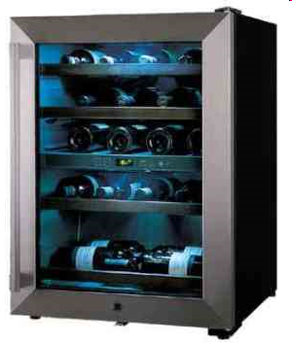
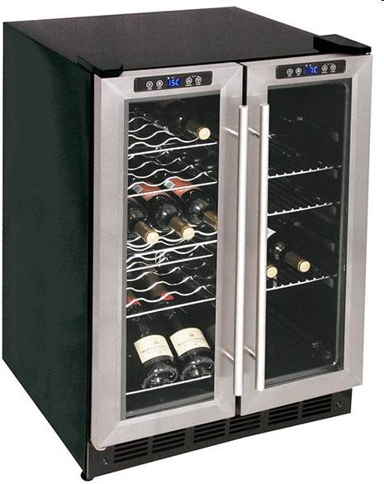
Wine Chiller
Storing & Chilling wines

Slide 22
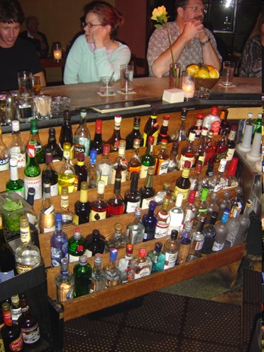
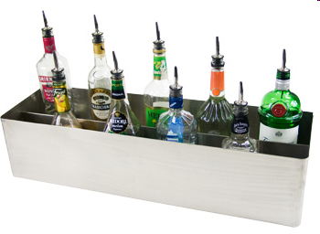
Speed Rails/Rack
Used to hold bottles for speed service

Slide 23
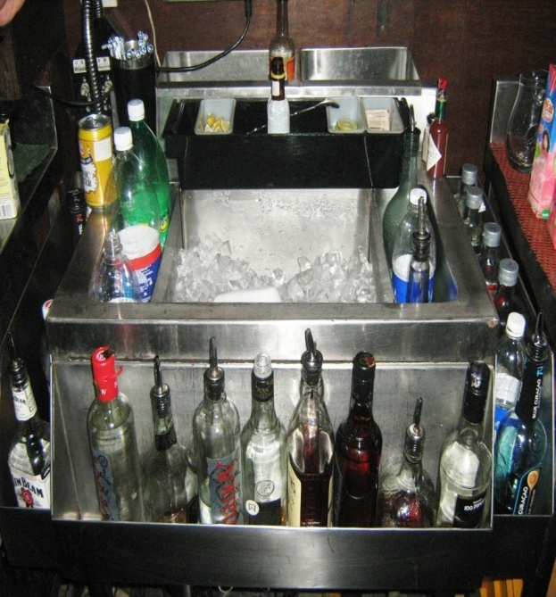
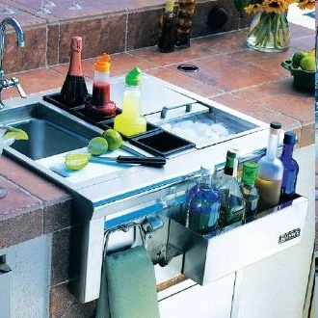
Work/Cocktail Station
Place used for cocktail preparation

Slide 24
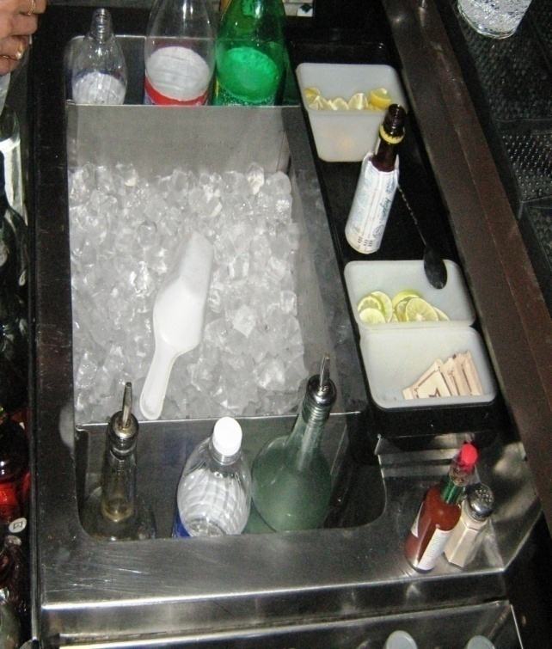
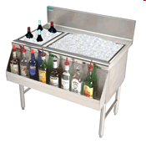
Ice Bin
Store Ice

Slide 25
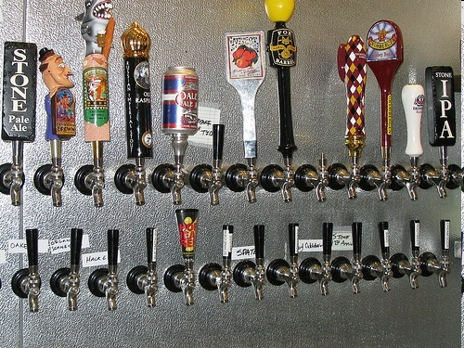
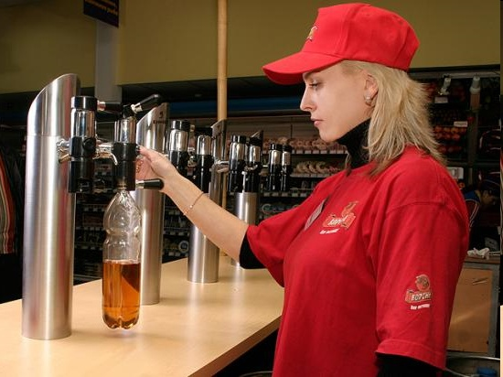
Beer Panel
Fast service of draft beers

Slide 26
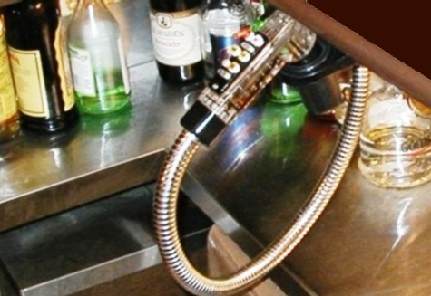
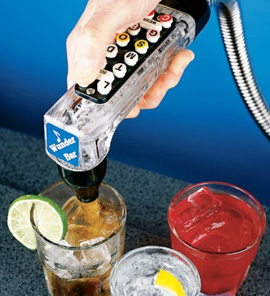
Soda/Bar Gun
Dispensing of aerated or soft beverages/mixers

Slide 27
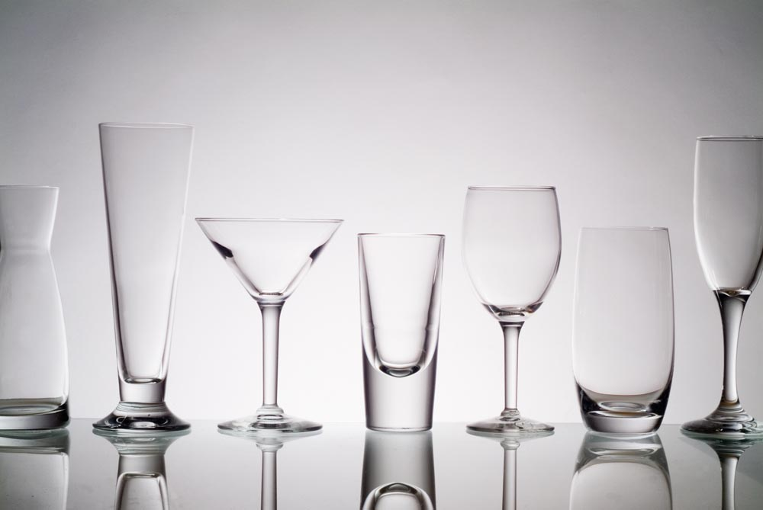
Glassware

Slide 28
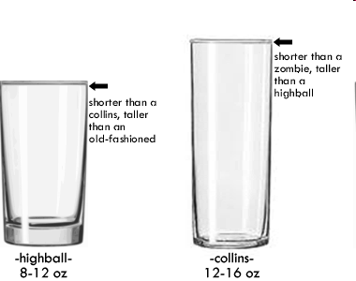

Highball
Ounce: 8 – 12

Slide 29


Collins
Ounce: 12 - 16

Slide 30


Old Fashioned
Ounce: 8 - 12

Slide 31


Pilsner
12- 14 ounce

Slide 32


Beer Goblet & Beer Mug
Beer Goblet Beer Mug
12-14 ounce 12-14 ounce

Slide 33



Champagne Glass
Tulip Flute Saucer
5-7 ounce 5-7 ounce 5-7 ounce

Slide 34


Wine Glass
White wine Red wine
5 ounce 7 ounce

Slide 35


Cocktail Glass
3 – 5 ounce

Slide 36


Brandy Balloon
8 – 10 ounce

Slide 37


Shot Glass
1 to 3 ounce

Slide 38


Sherry Glass
3 to 4 ounce

Slide 39


Port Glass
3 to 4 ounce

Slide 40


Liqueur glass
3-4 ounce

Slide 41
COCKTAILS
RISE ON
Vodka 45ml
Green chilly 1no
Red chilly 1no
Coriander leaves
Sprite Top up
METHOD MUDDLED

Slide 42
WHISKSPHIRE
Whisky 45ml
Blue Curacao 5ml
PINEAPPLE JUICE 80ml
LIME JUICE 5ml
METHOD SHAKEN

Slide 43
SPICYDICE
Vodka 45ml
Spices
Lemon 1wedge
Sprite top up
METHOD MUDDLED

Slide 44
CINNI MIST
Whisky 45ml
Lime juice 10ml
Apple juice 120ml
Cinnamon syrup 10ml
METHOD SHAKEN

Slide 45
SHANDY SIP
Beer 120ml
Sprite 120ml
Lime juice 5ml
METHOD BUILT UP

Slide 46
Thank you Cheers….

Slide 47









Our Clients

