Slide 1
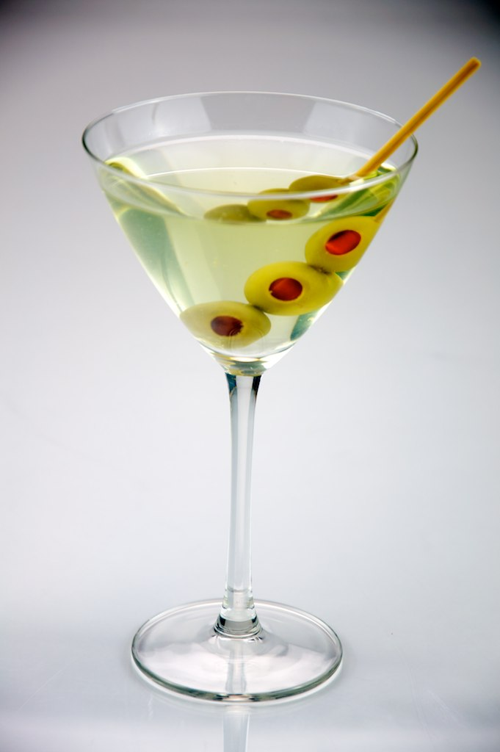
Cocktails

Slide 2
What is a cocktail?
cocktail (plural cocktails)
Noun - A mixed alcoholic beverage

Slide 3
Liquor
There are many different types of ingredients that go into cocktails. Most of these ingredients are alcoholic beverages or “Liquor.”

Slide 4
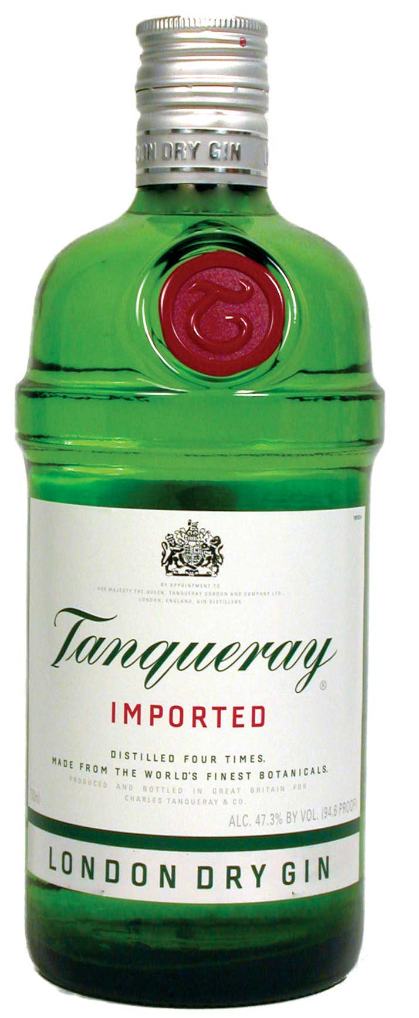
Gin
Gin is made from various types of grains and is flavored with Juniper berries. The most famous gin comes from England.

Slide 5
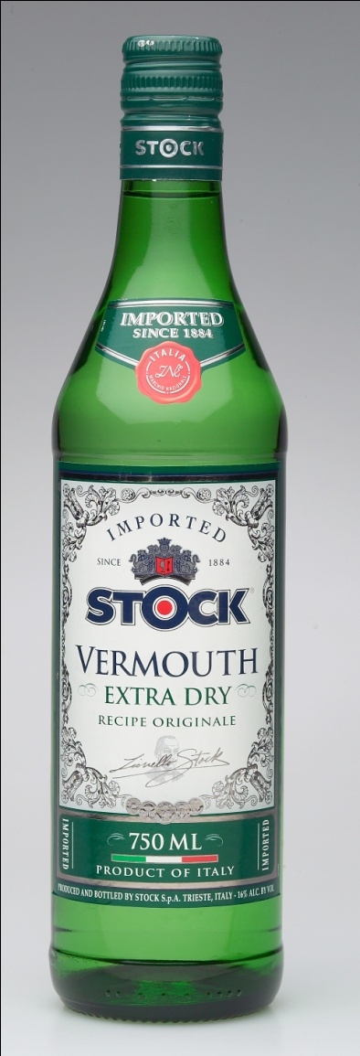
Vermouth
Vermouth is a strong wine made from grapes and flavored with different herbs. The most famous vermouth comes from Italy and France.

Slide 6
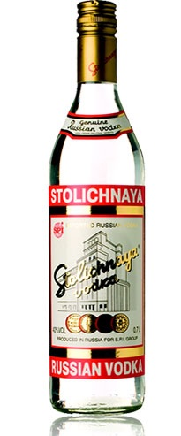
Vodka
Vodka is a strong, clear liquor. It is usually made from grain, but it can also be made from potatoes. The most famous vodka comes from Russia.

Slide 7
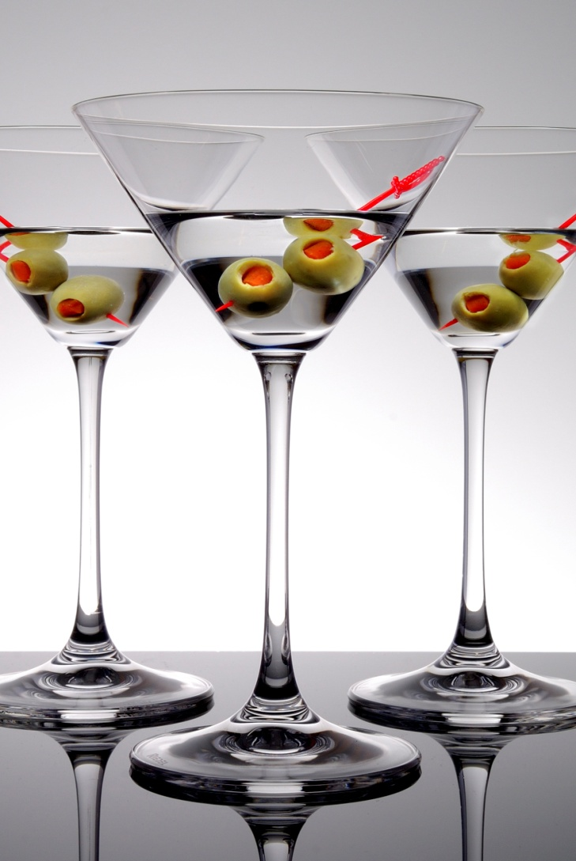
Martini
Ingredients: | 55 ml gin 15 ml dry vermouth
Preparation: | Pour all ingredients into mixing glass with ice cubes. Stir well. Strain in chilled martini cocktail glass. Squeeze oil from lemon peel onto the drink, or garnish with olive.

Slide 8
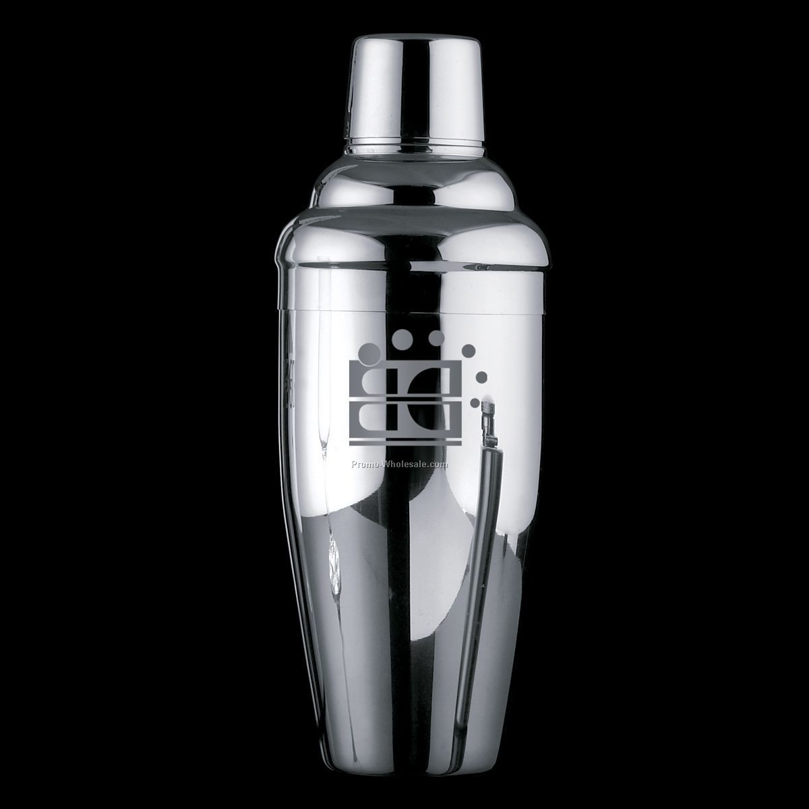
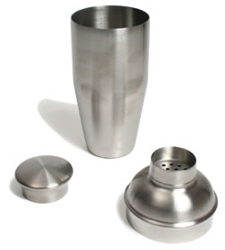
Cocktail Shaker

Slide 9
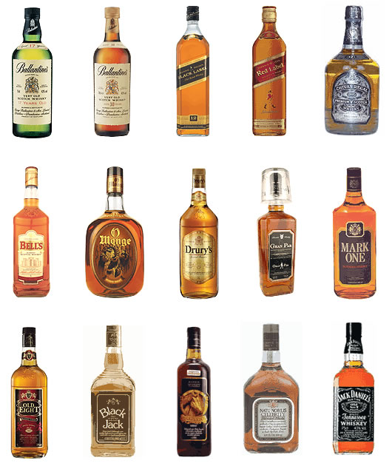
Whiskey

Slide 10
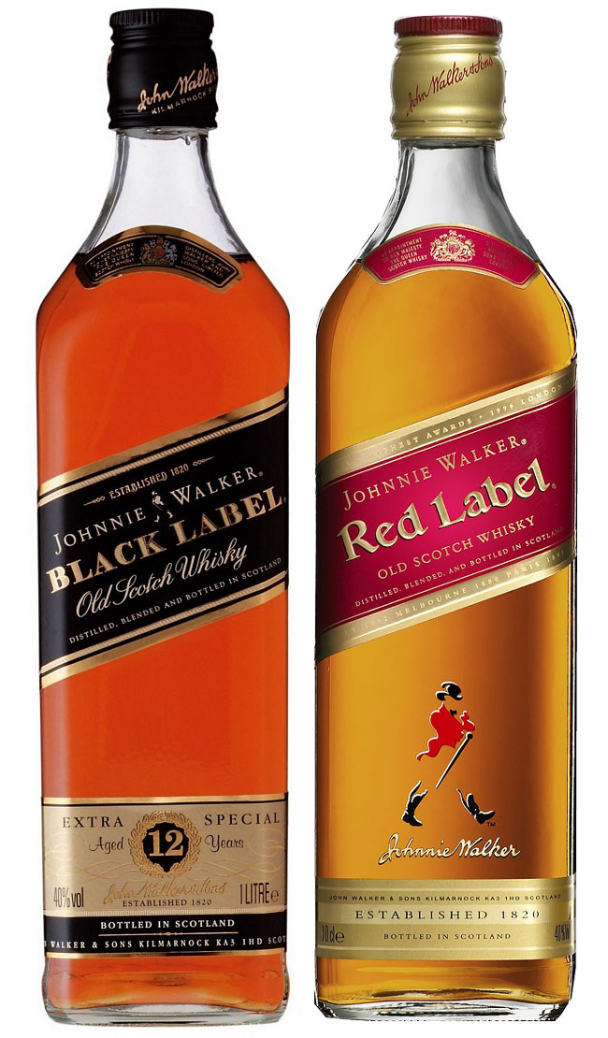
Scotch
Whiskey (or Whisky) is a dark brown liquor made from grain. It gets its flavor and color from the oak barrels it is stored in.
There are many different types of whiskey. One of the most famous kinds of whiskey is Scotch, which is from Scotland.

Slide 11
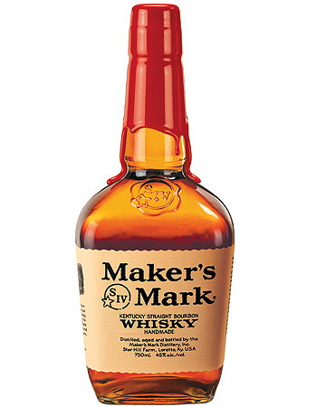
Bourbon
Another famous type of whiskey is called Bourbon. It is an American whiskey, made from corn. While Scotch whiskey tastes smooth and dark, Bourbon is strong and harsh.
Real Bourbon must be made in Bourbon County, Kentucky.

Slide 12
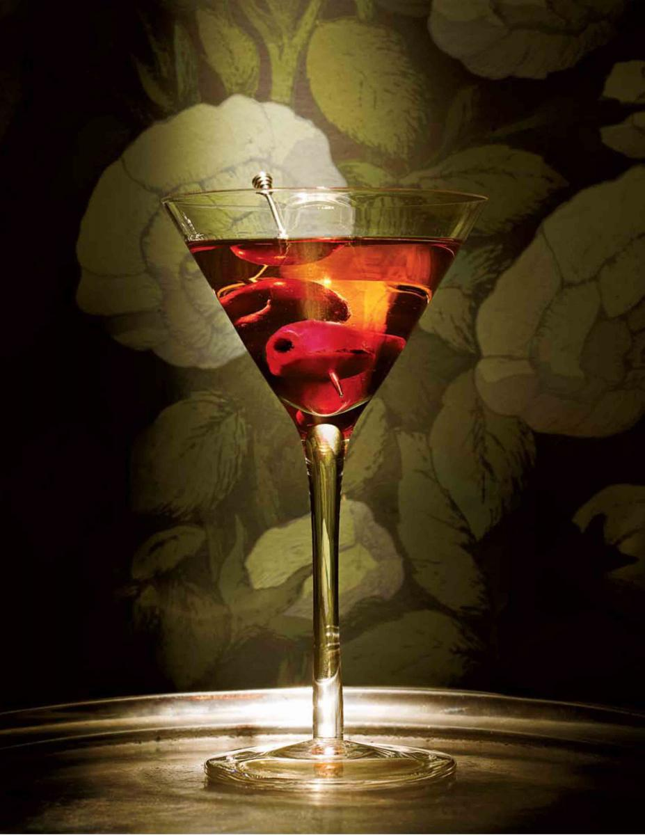
Manhattan
Ingredients: | 50ml Rye or Canadian whisky 20ml Sweet red vermouth Dash Angostura bitters Maraschino cherry (Garnish)
Preparation: | Stirred over ice, strained into a chilled glass, garnished, and served straight up.

Slide 13
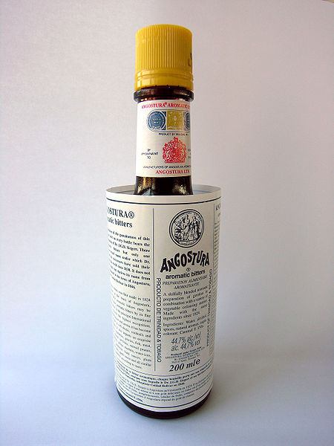
Angostura bitters

Slide 14
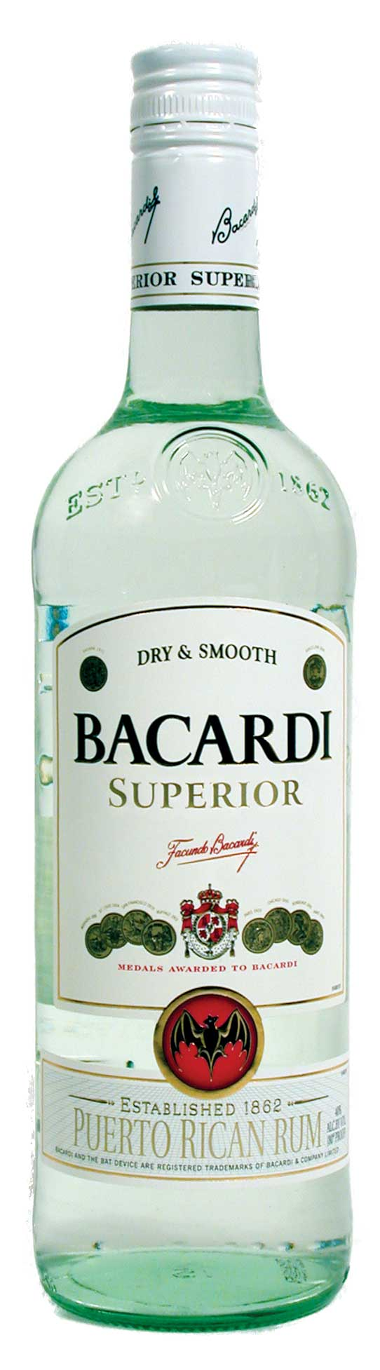
Rum
Rum is a liquor made from sugarcane. It can be either light or dark in color. The most famous rum comes from Caribbean islands such as Cuba or Puerto Rico

Slide 15
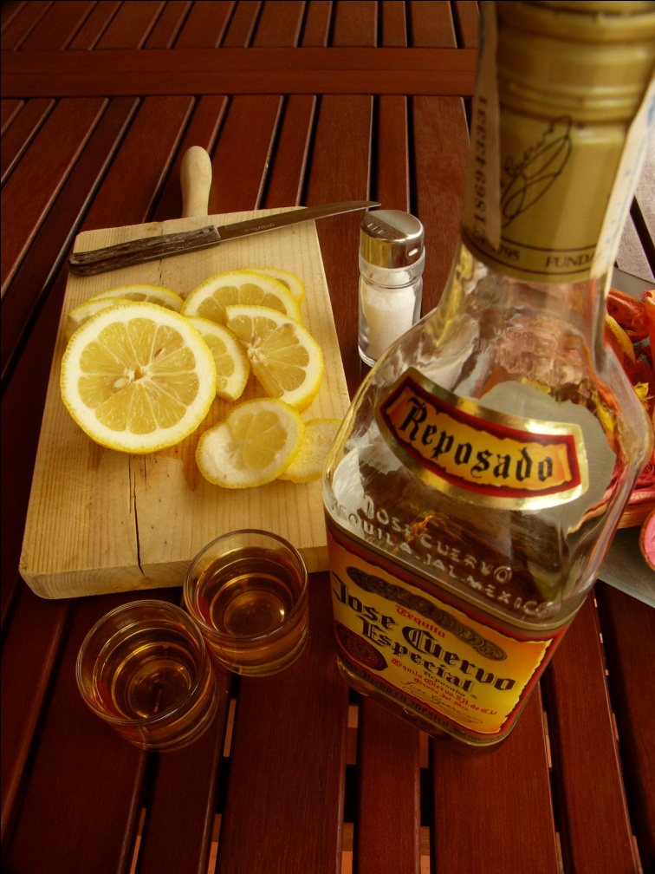
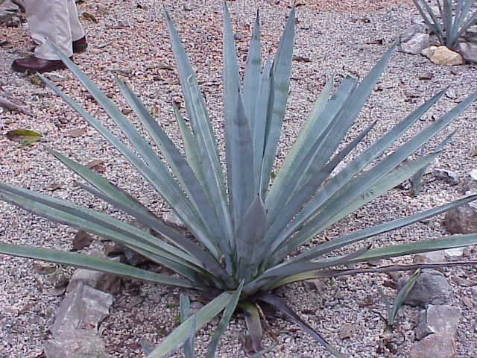
Tequila
Tequila is a harsh tasting liquor made from the Blue Agave plant. All of the world’s Tequila comes from Mexico.

Slide 16
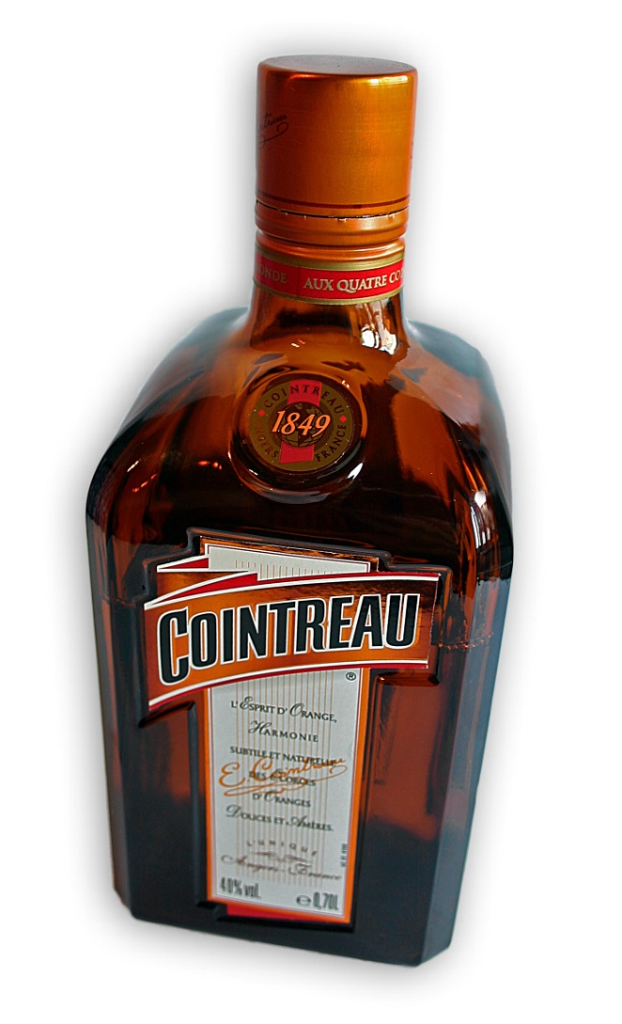
Triple Sec
Triple sec is a sweet tasting liquor made from orange peels. There are many different brands of Triple sec, but Cointreau, the most famous kind, comes from France.

Slide 17
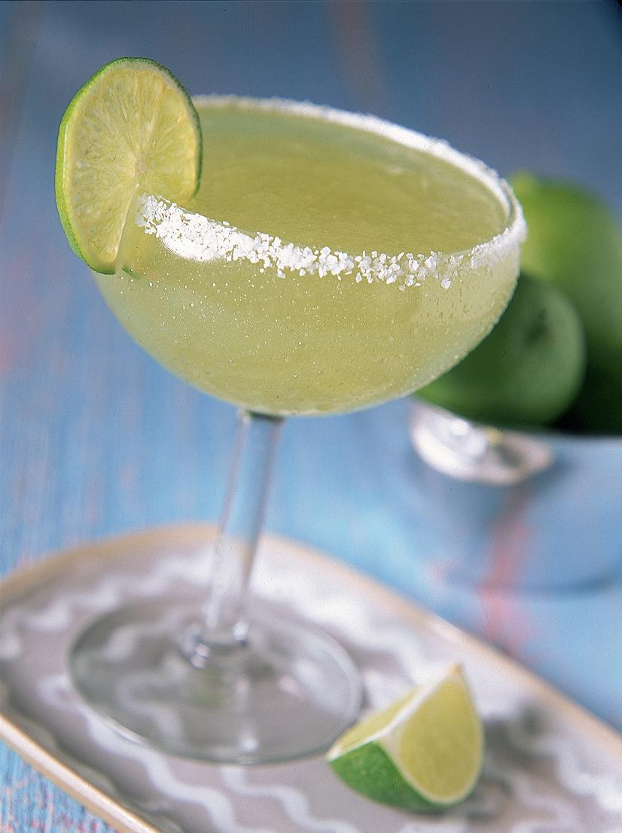
Margarita
Ingredients: | 35 ml (seven parts) tequila 20 ml (four parts) Cointreau orTriple Sec 15 ml (three parts) lemon or limejuice
Preparation: | Rub the rim of the glass with the lime slice to make the salt stick to it. Shake the other ingredients with ice, then carefully pour into the glass (taking care not to dislodge any salt). Garnish and serve over ice.

Slide 18
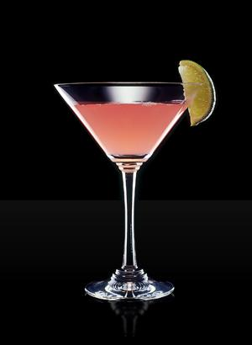
Cosmopolitan
Ingredients: | 40 ml Vodka Citron 15 ml Cointreau 15 ml Fresh lime juice 30 ml Cranberry juice
Procedure: | Add all ingredients into cocktail shaker filled with ice. Shake well and double strain into large cocktail glass. Garnish with lime wheel.

Slide 19
What would you like to drink?
What is your favorite kind of drink? What would you most like to try?
When you drink, do you go to a bar, a restaurant, or someone’s home?
How are Western drinks different from Chinese?

Slide 20
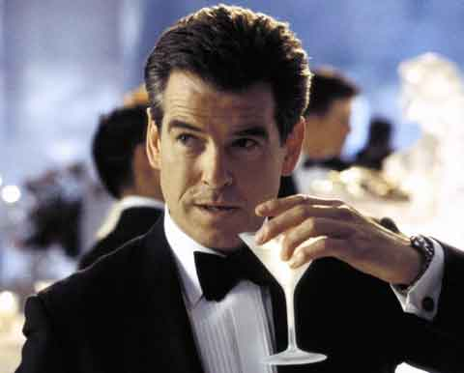
Famous Drinkers

Slide 21
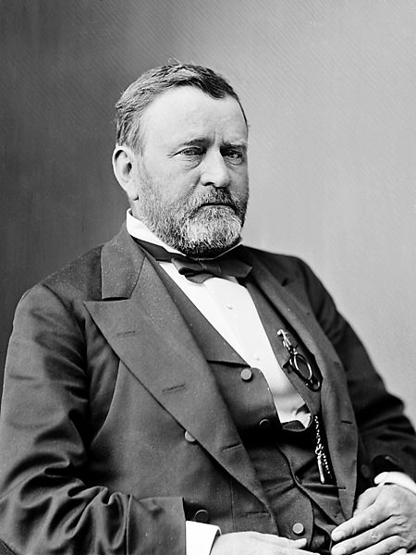
Ulysses S. Grant (1822-1885)

Slide 22
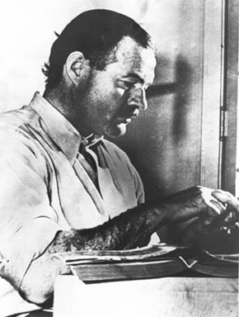
Ernest Hemingway (1899-1961)

Slide 23
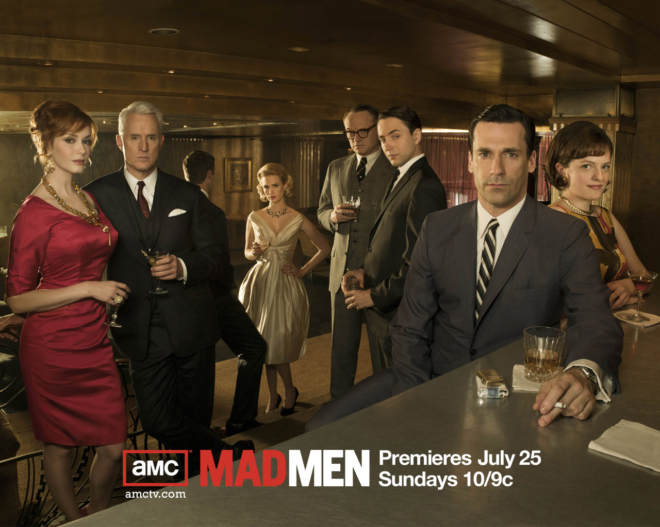
Mad Men

Slide 24
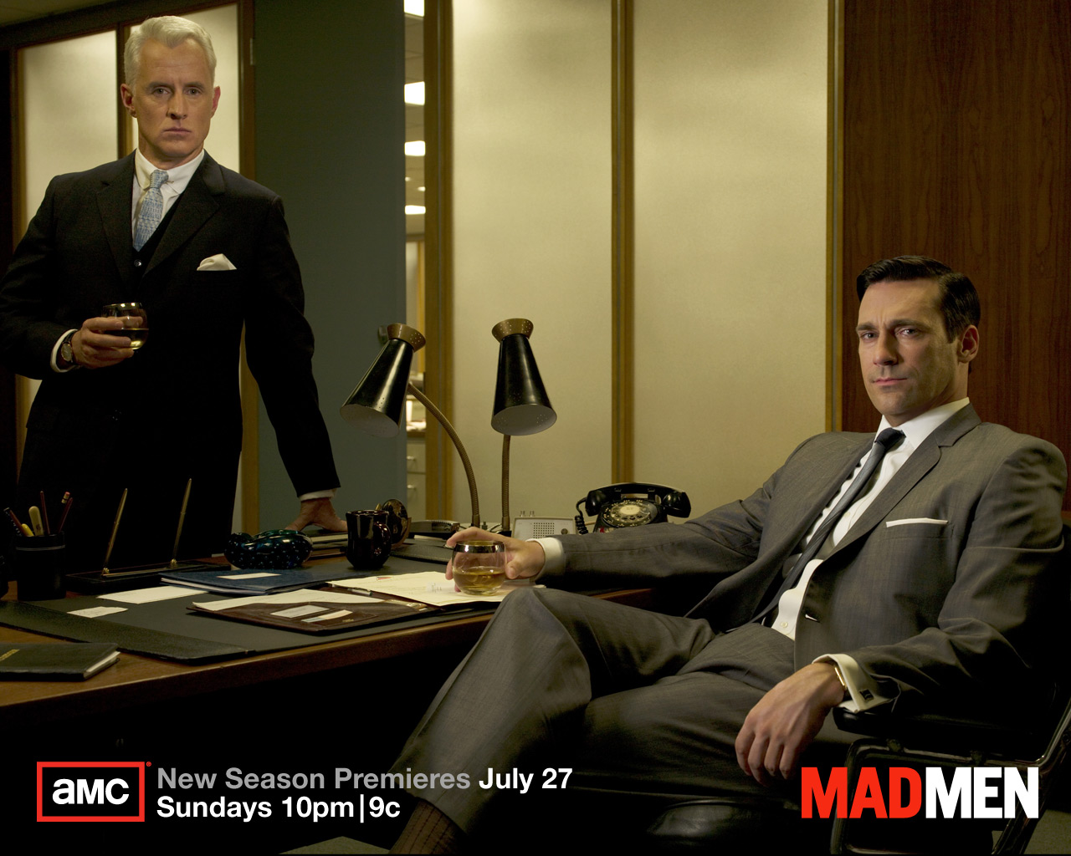

Slide 25
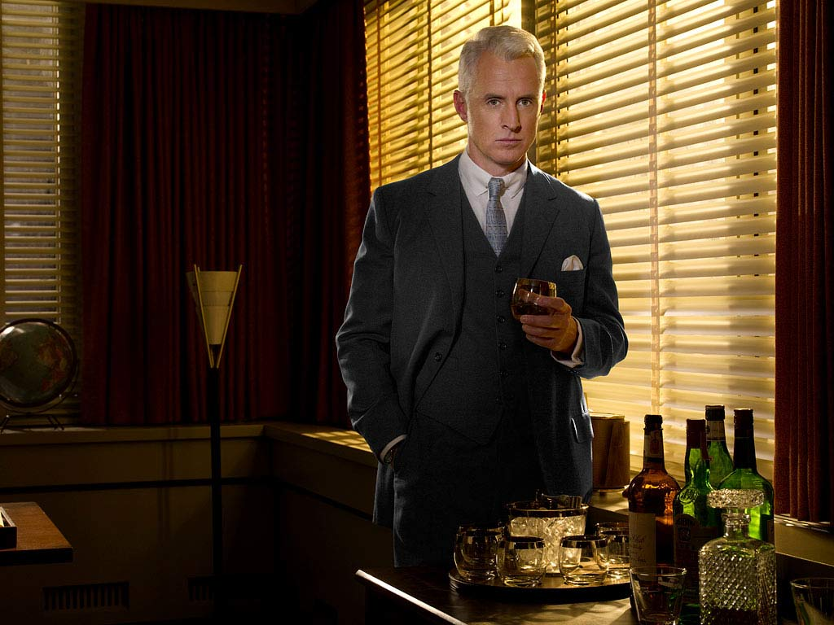

Slide 26
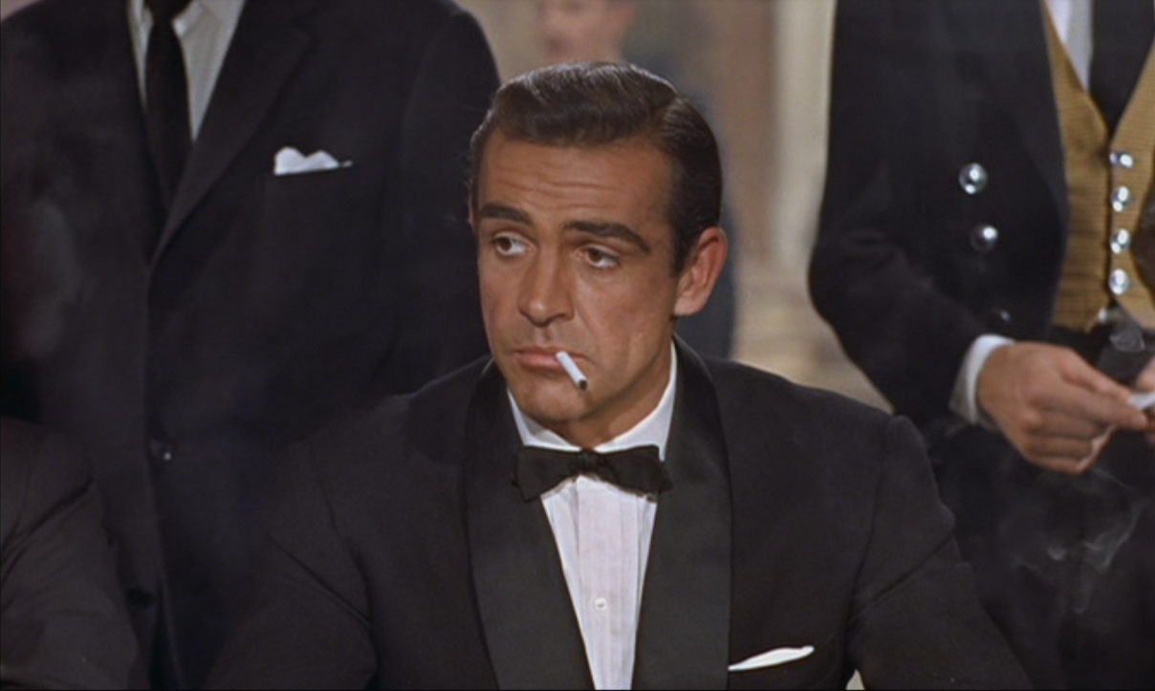
James Bond - 007

Slide 27
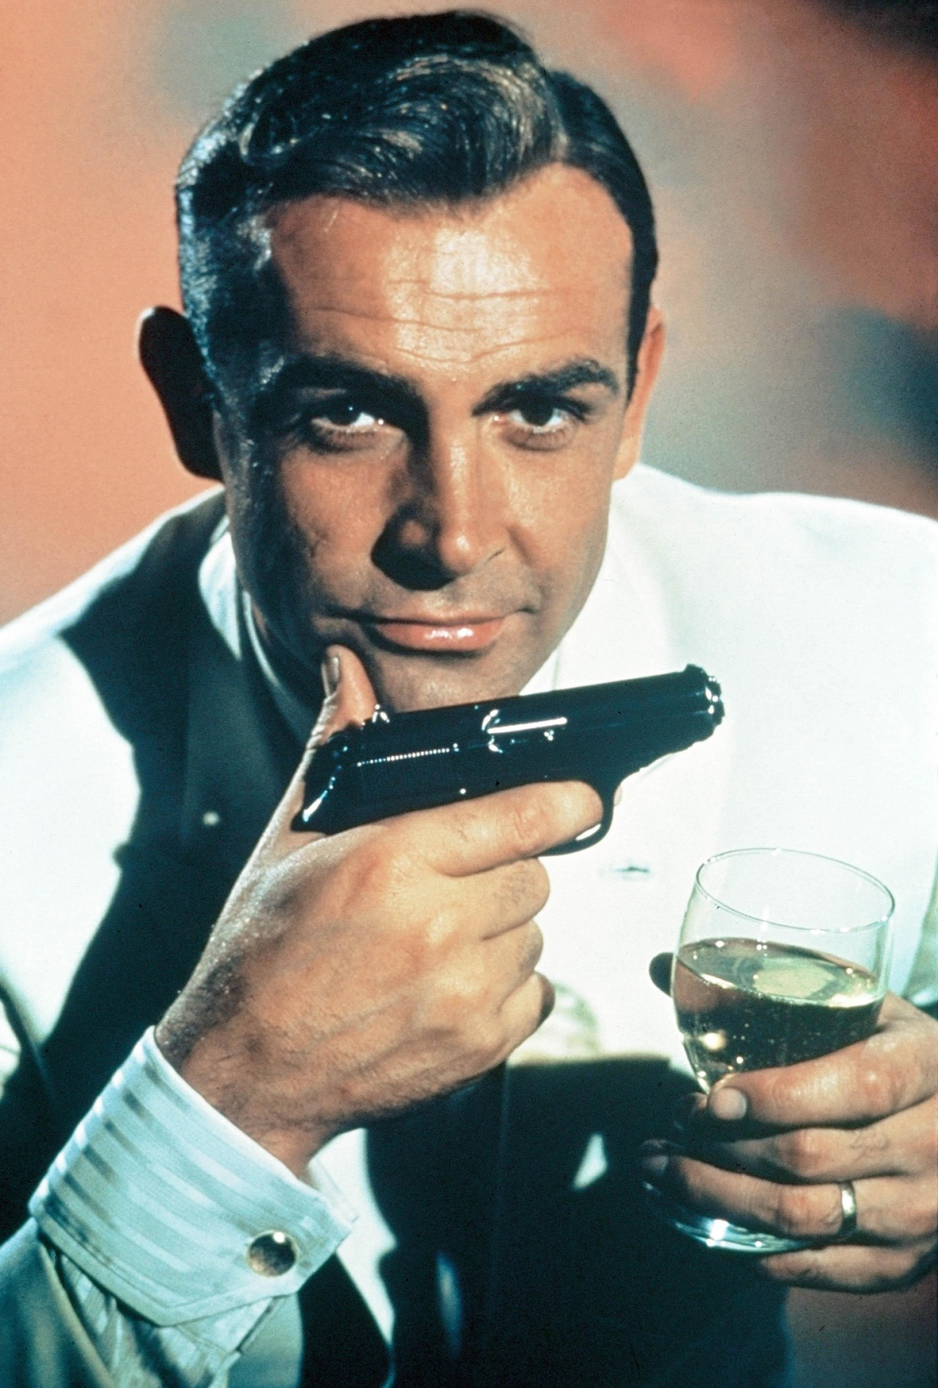

Slide 28
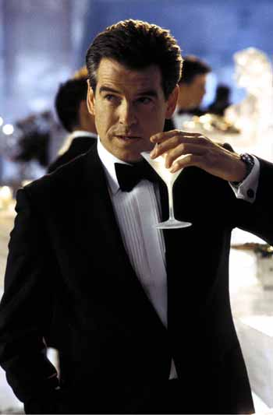

Slide 29
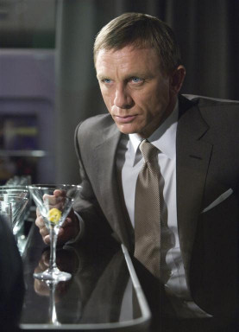

Slide 30
Famous Drinkers
Who are some famous drinkers from Chinese culture?
How is drinking treated in Chinese stories and movies?
What is the most you have ever seen someone drink?

Slide 31
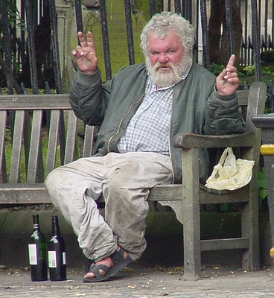
Alcoholism

Slide 32
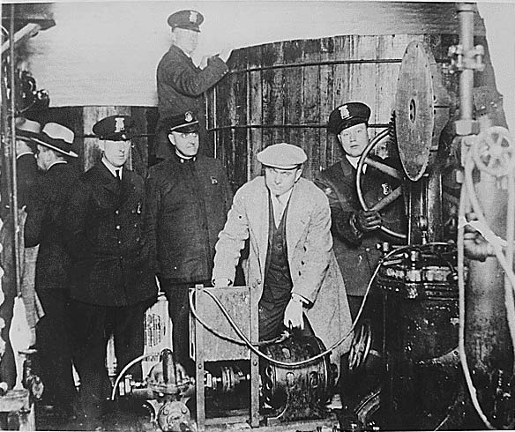
Prohibition (1920-1933)

Slide 33
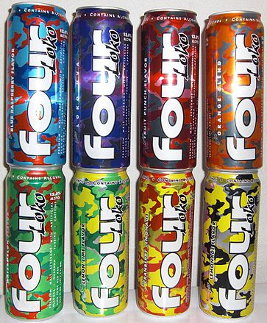
4 Loko

Slide 34
What do you think?
Should governments decide what kinds of things people should and should not drink?
What do you think of countries where alcohol is illegal?
What do you think of people who drink too much?
What is the strangest thing you have ever seen someone do after drinking?

