Slide 1
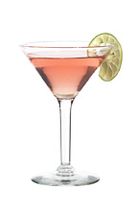

BARTENDING

Slide 2
what is cocktail?
COCKTAIL is a mixed drink made up of base liquor, a modifying ingredients and a mixer presented with a garnish.

Slide 3
Three elements of cocktail:
Base liquor – it determines the type of cocktail. It consists of single spirituous liquor or a combination of wines, liqueurs or aromatic wines.
Modifier- it gives flavor and smell to the cocktail.
Ex. Grenadine Syrup, Almont Extract, Tabasco, Worcestershire Sauce, Angostura bitters, Mint, Gomme Syrup, Cream, Honey, Milk
Mixer- It neutralizes the sharpness in the base liquor and perking up the drink itself. Also called as fillers.
Ex. Tonic Water, Sodas, Colas, Fresh Fruit Juice, Ginger Ale, Lemonade, Tomato Juice

Slide 4
What are the Classification of cocktail?
International Cocktail – are cocktails that are recognized worldwide
Ex: French 75, Moscow Mule, Zombie, Long Island Iced Tea, Red Eye
Tropical Cocktail – are cocktails that are heavily blended with fresh fruits
Ex. Mai Tai, Piña Colada, Daiquiri, Tequila Sunrise

Slide 5
Classic Cocktail – are cocktails named after a person or places
Ex: Margarita, Manhattan, Rob Roy, White Russian
Shooter – Cocktails with a combination of two or more liqueurs. It should be served flaming and drunk in one gulp.
Ex. B52, Orgasm, Slippery Nipple
Mocktails –non-alcoholic drinks
Ex: Four Season, Shirley Temple, Orange Squash, Lemon Squash

Slide 6
Categories of cocktails:
1. PRE-DINNER DRINKS
They are drinks served prior to a meal intended to stimulate appetite. They are also called aperitif. Any drink that contains gin, vermouth or Campari, wines, sparkling wines, straight liquor mixed with soft drinks or water and cocktails are good choices of pre-dinner drinks such as Martini, Rob Roy or Scotch Manhattan, Gimlet, Gin and, Negroni, Campari Cocktail. It is important to remember aperitifs are served without straws and usually without ice cubes.

Slide 7
2. AFTER DINNER DRINKS or DIGESTIF
These are drink served after a meal, as the term implies. They are usually sweet and are intended to round off the meal.
And there are types of after dinner drinks

Slide 8
TYPES OF AFTER- DINNER DRINKS:
Liqueurs - Also known as cordials, liqueurs are sweetened spirits flavored with ingredients such as seeds, fruits, herbs, flowers, nuts, spices and even roots, barks and leaves. The flavor is either added during the distillation process, infused (flavorings are steeped in hot water and mixed with the alcohol based, macerated (flavors are steeped directly in the alcohol base), or percolated (the base itself is dipped through the flavoring agents just as you would with coffee)

Slide 9
Distilled Spirits - Flavorful single-malt whiskeys, fine rums or aged tequila all go down easy on their own after dinner or in cocktails. Brandies, Cognacs and Armagnac are other popular choices. Calvados, the traditional Normandy brandy made from apples has been enjoyed as a digestif even between courses since ancient times.

Slide 10
Wines - A small glass of sweet or fortified wines such as Port, Sherry or Madeira can also finish off a meal nicely.
Coffee Drinks - After dinner drinks can be served alongside coffee- or the two can be happily combined for a caffeinated “cocktail”. A simple shot of rum or whisky in a mug of freshly brewed coffee is more than enough to satisfy fans of less sweet drinks, but you can also think adding Baileys, Grand Marnier or Amaretto along with a topping of whipped cream

Slide 11
And
Cocktails - A Grasshopper, Brandy Alexander or a Black Russian with Kahlua and Vodka all combine liqueurs that are traditionally served after dinner to create new flavor combinations

Slide 12
3. LONG DRINKS
A long drink or tall drink is an alcoholic mixed drink with a relatively large volume (between 5 - 9 fluid ounces). It's the classic name for all mixed drinks that consist of more than 5 ounces of liquid.
This terminology had fallen out of favor over the last decade or two, but is now enjoying a revival. Typically, a long drink will have lots of ice and mixer, perfect for warmer days, as opposed to a short drink.

Slide 13
4. FANCY DRINKS
They are imaginative drinks that do not fit into any category of alcoholic mixed drink or cocktail and for which there are no basic recipes. The sole stipulation is that they should contain a maximum of 2 ounces of alcohol and taste good.
Pick-me-ups come under the category of fancy drinks. They are usually heavily seasoned and are popular hangover cures. One of the most known is the Bloody Mary.

Slide 14
ALCOHOLIC AND NON-ALCOHOLIC INGREDIENTS OF COCKTAILS and SUBSTITUTES:
ALMOND LIQUEUR- Amaretto
ANGOSTURA BITTERS- Made from a secret blend of rare tropical herbs and spices. It is said to contain 40 ingredients and was developed by Surgeon General Dr. J. Siegart who spent 4 years devising the recipe that would improve the appetite and well being of his troops.

Slide 15
BITTERS- Are made from herbs and/or fruits. The most common bitters is Angostura bitters.
CHERRY JUICE- Grenadine.
CINNAMON- A dried inner bark of tropical Asian tree in the genus cinnamon.
GINGER ALE- Ginger flavored carbonated soft drinks .
GRENADINE SYRUP- Strong red syrup made with redcurrants and pomegranate. It acts as a coloring and sweetener.
LEMONADE/ LEMON SODA- A carbonated soft drinks i.e. Mountain dew.

Slide 16
HALF AND HALF- Equal amount of fresh milk and all purpose cream.
HERB LIQEUER- Galliano
LIQEUERS or CORDIALS- They are neutral spirits made by adding herbs, flowers, juices or fruits used as flavoring or coloring to the cocktail.
MARASCHINO CHERRIES- A sugar syrup coated cherry, dyed red and flavored with almond.
NUTMEG- A spice, seed of fruit produced by the Myristica fragrance tree.
OLIVE- A small oval fruit of the Mediterranean evergreen tree.

Slide 17
ORANGE LIQEUER- Triple Sec, Curacao, Grand Marnier, or Cointreau
PRES- Equal amount of ginger ale + club soda or soda water
PIÑA COLADA- Rum + piña mix
PIÑA MIX- Equal amount of pineapple juice and coconut milk
GOMMESYRUP or SUGAR SYRUP- 1 part boiling water + 1 part sugar.
SODA- Tonic water, soda water, soft drinks (Sprite/7-up)

Slide 18
SPIRITS or LIQUOR- These are used as a base for cocktail mixing such as Gin, Vodka, Tequila, Rum, Brandy and Whisky.
SWEET AND SOUR or SOUR MIX- Equal amount of lemon juice and simple syrup.
TABASCO SAUCE- A fiery pepper flavored sauce made from fully aged red peppers, salt and distilled natural vinegar.
TONIC WATER- Fruit flavored carbonated water made with fruit extracts, sugar and quinine ( a bitter taste in the tonic water)

Slide 19
WINES- such as table wines, Sweet & Dry Vermouth and Campari.
WORCESTERSHIRE SAUCE- A dark seasoned sauce containing soy sauce, garlic, onion, molasses and lime amongst other various ingredients.

Slide 20
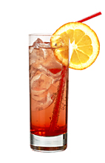
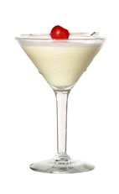
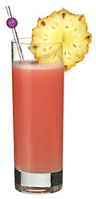
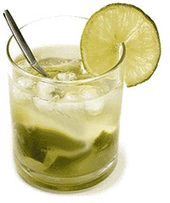
Common Edible garnishes used in cocktail:
1. Orange
2. Pineapple
3. Cherry
4. Lime

Slide 21
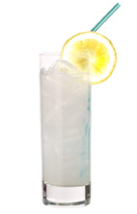
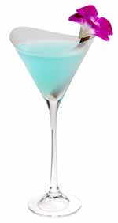
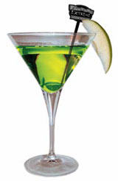
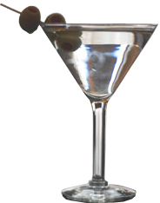
5. Lemon
6. Olives
7. Orchid
8. Apple
Etc……………………………..

Slide 22
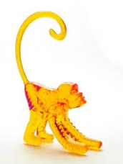
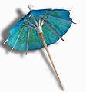

COMMON INEDIBLE GARNISHES used in cocktail:
Plastic Animals(attached to the rim of the glass)
Bead necklaces
Candles
Cocktail umbrellas paper
Drinking straws
Fire (see Flaming beverage)
Flags
Plastic Swords
Sparklers
Swizzle sticks
Other decorations (usually made of paper or plastic)

Slide 23
QUALITY GUIDELINES FOR GARNISHES:
1. Always wash fruit in cold water before cutting.
2. Always use a cutting board.
3. Use a clean sharp knife.
4. Always store garnishes refrigerated and covered.
5. Never put old garnishes on top of new garnishes
6. When storing garnishes which have been in production, rinse them with soda and refrigerate
7. Olives and cocktail onions should be stored in their own juice.
8. Cut celery should be stored in water to retain crispness.

Slide 24
Cocktail garnishes are decorative ornaments that add character or style to a mixed drink, most notably to cocktails.
A large variety of cocktail garnishes are used. Many rum-based cocktails, especially those with fruit flavors, tend to be decorated with tropical-themed garnishes or slices of fruit. Tequila-based drinks favor limes and other citrus fruits. Gin- and vodka-based drinks tend toward garnishes with a more dignified flair (olives, onions, or possibly a citrus twist or a single maraschino cherry), unless they are variations of a fruity rum-based drink. Whiskey- and brandy-based drinks tend toward minimal garnishment, if any.

Slide 25
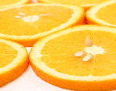
Procedures on how to make orange garnish:
Materials to be needed:
-Bar knife, cutting board, garnish tray, canelle knife, zester, fresh orange fruit.
1. Slice
-Wash oranges thoroughly.
-Cut oranges in half crosswise.
-Cut 6 mm thick slices crosswise from
each of the orange halves.

Slide 26


2. Half-moon
-Same procedure on number 1.
-Cut orange slices in half again to
form half moon shaped slices.
-Make a small cut in the middle of the half moon.
-Place it on the rim of the glass.
3. Twists
-Start with a half moon orange slice.
-Make cuts in the slice from center out to
edge and barely through the skin.
-Twist each cut end in opposite directions to form an orange twist.
-Serve on the side of a glass or in it.

Slide 27

4. Cartwheels
-Wash oranges thoroughly.
-Before cutting the orange into slices cut notches lengthwise using a zesting tool.
-Hold the orange in one hand and pull the zesting tool from one end to the other, cutting a notch in the skin.
-Continue to cut lengthwise notches from the rest of the orange with 4 mm (approx.) spacing.
-Cut the notched orange into slices and display on the rim of the glass.

Slide 28
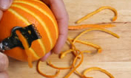
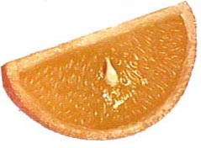
5. Zest- Orange zest is the peel of the orange
except the white part.
-Use a knife or vegetable peeler to
carefully peel only the orange part off.
-Either finely chop or slice or squeeze to bring the orange oils over the drink before placing it in.
-Use strips of peel and carefully tie each strip into a knot.
6. Wedge
-Wash oranges thoroughly.
-Cut off the ends of the orange.
-Slice orange lengthwise into 6 or 8 wedges.
-Cut a slit in the middle so you can place it on the glass.

Slide 29
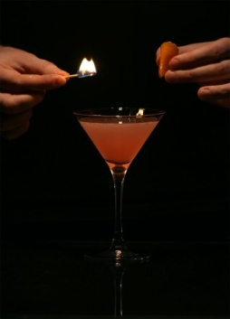
7. Flamed Zest
Very simple procedure that imparts a very aromatic citrus flavor to your drinks making a good use of the orange zest in cocktails.
-Take the zest with one hand and
the lighted match with the other.
-Spray the oils of the zest onto the drink while you put the fire close to it, you will see little sparks, literally.
-Drop the zest in for better flavor.

Slide 30

8. Spiral
-To make a spiral of citrus peel, use a pare or vegetable peeler to cut away the skin, working in a circular motion.
-Take care not to cut into the bitter pith.
-You can also use a zester to get a fine, long zest and then twirl it around a stirrer, that way the zest will take the spiral shape, once you release it.

Slide 31
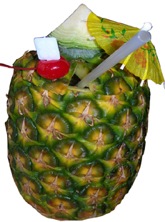
Procedures on how to make pineapple garnish:
Material to be needed:
-Bar knife, cutting board, garnish tray, fresh pineapple fruit.
1.Whole pineapple
-Remove the crown by cutting it by knife.
-remove the flesh by starting on the
middle and not damaging the outside of
the pineapple.

Slide 32
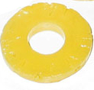
2. Slices /Rings
-Remove the plume by cutting it at the crown with knife.
-Begin slicing the pineapple at the end where the plume was removed.
-Continue to cut the pineapple into
approximately 1 1/2 cm thick slices.
-Cut slices to the end of the pineapple.
-After rings have been sliced, use a small knife to cut around the outside of the slices to remove the rind.
-Remove any "eyes" from the edge that remain after trimming off the rind.
-To core the pineapple, use a knife to cut around the hard center core of the pineapple.
-Remove the core of the pineapple to produce the pineapple ring. The core can also be cut out by using a corer, a small cookie cutter, or a donut hole cutter.

Slide 33

3. Wedges
Remove the plume by cutting it at the crown with a sharp knife.
-Begin slicing the pineapple at the end where the plume was removed.
-Continue to cut the pineapple into approximately 1 1/2 cm thick slices.
-Cut slices in triangle to obtain the wedges.
-Cut a slit and use it to garnish the glass.

Slide 34

Procedures on how to make apple garnish:
Materials to be needed:
Bar knife, cutting board, garnish tray, corer, and fresh apple fruit.
1. Slice
-Cut whole apple, crosswise.
-Remove the core using a corer.

Slide 35



2. Apple Wedge
-Wash, dry and cut lengthwise.
Cut crosswise about ¼ inch .
-3. Apple Zest
-Peel apple by using a sharp
knife or a peeler.
4. Cubed Apple
-Using a sharp chef's knife, made
straight cuts on thick slices of apples
and gets cubed apples.

Slide 36
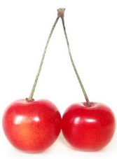

CHERRY GARNISH
Many different types of cherries can be used for garnishing cocktails.
-Cherries are speared onto orange slices, pineapples, limes, and lemons. This type of decoration is called “flag” in the cocktails world. The most common are: Maraschino Cherries, Red Cherries, Yellow Cherries, and Green Cherries.
-If you choose for the fresh cherries such as Maraschino, you must always pick the fresh red cherries with stalks. Although they add little flavor when dropped into a drink, they add bright colors to a drink, it is better to get them with the stem attached so that the drinkers can eat it as well.
-If your choices are canned cherries, use a paper towel to dry them before placing them over the drink, sometimes the syrup contained in them could ruin the esthetics of your cocktails.

Slide 37
Procedures on how to make lime garnish:
Lime is a very popular fruit for garnishing cocktails. It can be used in a great variety of shapes to add color and a hint of flavor to the finished cocktail.
-Choose limes that are ripe and have no bruises on the skin.
-The lime piece is used to moisten the rim of the glasses in drinks such as Margarita or Side Car so that the salt or sugar will adhere to the rim of the glass.

Slide 38
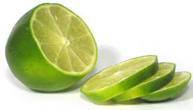
1. SLICE
-Lime slices are also called wheels. It
is ideal for garnishing cocktails for their great look.
-Cut the lime crosswise into 1/8 to 1/4 inch thick slices. This cut will create a slice in the middle of the lime wheel. The purpose of this is so that you can easily slide it onto the rim of the glass without juice squirting everywhere or ruining the look of the garnish.
-Make a small cut in the middle of each slice, beginning near the center, cutting outward through the rind

Slide 39
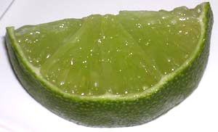
2. WEDGES
Lime wedges are very suitable garnish for long drinks served in highball glasses and other drinks. The thicker pulp of the wedge gives the drinker the option to squeeze more lime juice into the drink to add a consistent lime flavor.
-Wash the lime
-Cut ends off just to the pulp
-Set lime upright on the cutting board
-Slice lime completely in half lengthwise
-This cut will create a slice in the middle of the lime wedge. The purpose of this is so that you can easily slide it onto the rim of the glass without juice squirting everywhere or ruining the look of the garnish.
-Cut half way into the pulp lengthwise, but not down to the rind. Take care at the edges not to cut into the rind as they are not as thick as the middle of the lime.
-To finish off the lime wedge simply cut each half into sections. You can usually get 3-4 wedges from each half depending on the size of the lime.
-Turn the lime over so that it lays flat.
-Slice wedges into 1/4 to 1/2 inch pieces.

Slide 40

3. HALF MOON
-Cut slices into half again to create half moons of lime.
-Make a small cut in the middle starting in the center towards the rind of each half -moon lime and place on the glass.
4. SPIRAL
-To make a spiral of lime peel, use a parer or vegetable peeler to cut away the skin, working in a circular motion.
-Take care not to cut into the bitter pith.

Slide 41
5. TWIST OF LIME PEEL
-Cut a thin slice of lime peel, using a knife scrape off the pith; run the twist around the lip of the glass.
-Twist it over the drink to release the oils and drop it in.
6. ZEST
Lime zest is the peel of the lime obtained by using knife or vegetable peeler to carefully peel only the lime part off.
-Finely chop or slice or squeeze to bring the lime oils over the drink before placing it in it or you can use strips of peel and carefully tie each strip into a knot.

Slide 42
LEMON GARNISH
Lemon can be used as equal as oranges and limes. All depends on what they ask you in the recipe or what you consider it is appropriate.
- Cut off the ends of the lemon and then slice the fruit lengthways into 6 or 8 wedges, preferably with a slit in the middle so you can place the garnish on, not in, the glass. Wedges not only look nice but they're functional too: by squeezing the wedges, guests can easily add extra lemon to their drink without getting their hands covered in juice or pulp.
LEMON ZEST TWIST
-Cut a thin slice of lemon peel using a knife scrape off the pith; run the twist around the lip of the glass.
-Twist it over the drink to release the oils and drop it in.
-You may also flame the oils when they are squeezed out of the zest for getting more flavor and make it more attractive.

Slide 43

OLIVE GARNISH
Green olives are famous for being the garnish of traditional Martinis.
-It is recommended to serve olives without fillings such as red pepper, onion or almonds.
-Olives are served skewered on a pick and placed in the drink.
-Use black olives only when drink specifically calls to use it.
OLIVES JEWEL
-It is a common term for a decoration made with olives or onion in dirty martinis and cosmopolitans.
-It can also be applied for maraschino cherries, berries or small vegetables skewed on toothpick, stirrer or swizzle.

Slide 44
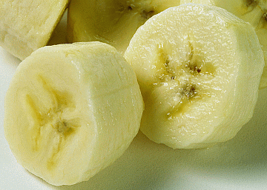
BANANA GARNISH
Yellow, firm, and sweet bananas for this purpose, slice it with or without peel.
Banana Slice
Banana Wheel

Slide 45
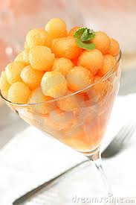
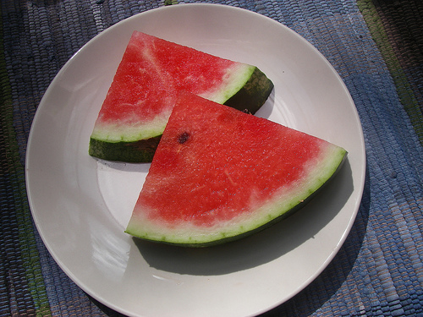
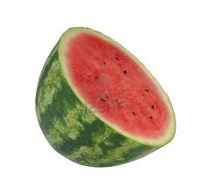
MELON GARNISH
Fresh and delicious melon can be cut in many different ways and presented as garnish at any cocktail requiring of this fruit.
melon ball melon wedge melon slice

Slide 46
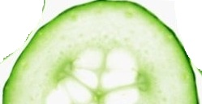
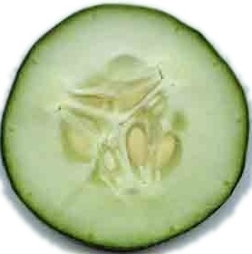
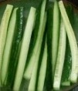
CUCUMBER GARNISH
Cucumber half-moon
-Wash a fresh cucumber very well, dry it with a towel paper, and cut cross lengthwise. Then slice and you'll get a half-moon shaped cucumber.
Cucumber Slice
-Wash, dry and slice.
Cucumber Spear
-Cut lengthwise and cut into strips/Julienne

Slide 47
THE BUILD PROCEDURE
The build procedure is the simplest and probably the fastest method of preparing drinks. When a drink is specified to be made in this method all ingredients are added directly to the required glass. This is suitable when a drink does not need much mixing or this specifically done to enhance the appearance.
The following sequence will allow for efficient and smooth preparation of any build cocktail.
1. Get the correct glass required. The most commonly used glasses are highball, the rock and the sling glass.
2. Fill the glass with the appropriate ice. Crushed ice may be used in a variety of cocktail, but cube ice is quite acceptable.

Slide 48
3. Most build drinks have the ice added first, only if iced mentioned be added, at a later time should this rule be broken.
4. Place the glass on the bar in easy reach. (As the ingredients will be added directly into the glass.)
5. Add ingredients to the glass in the order specified in the recipe. Topping ingredients must be added last to ensure a layered top appearance.
6. Add the appropriate straw or swizzle stick. Ensure that the length chosen is appropriate for the size of the glass.
7. Garnish appropriately. The garnish must add to the presentation of the drink and must not clash with the taste of the cocktail when the guest decides to consume the garnish.

Slide 49
STIR PROCEDURE
The Stir Procedure is used when a cocktail should be gently mixed and chilled. A customer may request this procedure by commenting “DO NOT BRUISE THE BOOZE”. It is commonly done for Martini, Manhattans and Rob Roy.
The actual stirring procedure is done with a cocktail spoon while the liquor is on ice in the mixing glass. Be sure to use the proper end of the spoon, as handled is considered unsanitary.
STIRRING PROCEDURE
1. Get the mixing glass for stirring cocktails.
2. Put ice about 3 to 5 cubes and place on the bar in front of the cocktail unit.
3. Add the appropriate mix and or liquor to the glass mixer.
4. Stir the cocktail with the appropriate end of the spoon enough to ensure adequate mixing and chilling but not excessive melting of the ice.
5. Pour the mixture by straining into the appropriate glass.
6. Garnish and serve the cocktail.

Slide 50
THE MIX PROCEDURE
Just like shaking and straining, but faster because a mixing machine is used.
1. Pour ingredients in the mixer.
2. Mix the drink.
3. Pour drink into proper glasses.

Slide 51
THE SHAKE PROCEDURE
If a drink contains lemon mix, lime mix or grenadine then the drink should be shaken to ensure proper taste. The grenadine, a thick, red and sweet syrup can only mix evenly when well shaken with the other ingredients in the cocktail.
1. Get the correct glass for that specific cocktail. (Most common glasses for shake cocktails are the Collins, Zombie, Sour, Champagne and Cocktail Glass.
2. Fill the glass with ice if necessary and place in front of the cocktail unit.
3. Take the glass portion of the shaker add scoop (3-5 large cubes) of ice and place it also on the bar by the glass.

Slide 52
4. Add the ingredients into the glass of the shaker. Adding the juices first then the liquor. (This is done in case the wrong juices are added if so the mixture can be discarded without loss of any liquor)
5. Pick up the metal shaker (Preferably back hand for ease of operation) and place over the glass portion. Press lightly to form a seal.
6. Pick up the complete shaker with your right hand on the metal on left of the glass. Placing the shaker into the tuck of your neck. Shake by extending your right arm. Shake for enough time to complete the mixing and cooling process. The direction of shaking should be off to the side while keeping eye to eye contact with the customers.
7. Return the shaker to the top of the bar. Removing the glass portion by snapping it to the nearside.
8. Place the strainer over top of the metal shaker and strain into the glass. If the drink was noted as a shake and top procedure then the item suggested for topping should be added now.

Slide 53
THE BLEND PROCEDURE
An electric blender is used to mix fruit juices, alcohol, fruit, etc. This method is an excellent way of mixing ingredients which are hard to mix in any other way like fruit juices, fruits, cream and eggs. This results in a creamy or smooth or homogenous consistency. If the recipe requires ice, add crushed ice last.
This method is not so interesting to watch and may be very noisy but it always ensure a fully mixed drink.
1. Place ingredients into the blender cup
2. Place cup firmly on the blender
3. Turn motor on start with slow motion
4. Continue blending until all ingredients are mixed well
5. Turn off blender, remove cup and pour drink into proper glass
6. Garnish and serve.

Slide 54
THE LAYERING PROCEDURE
Layering is a way of building a drink in a glass ­ often a shot glass. Every ingredient is gently and steadily poured into the glass so that it sits on top of the previous layer.
There are 2 suggested ways of layering using a bar spoon .
1.Hold the bar spoon touching the side of the glass and pour the ingredient carefully and slowly over it into the serving glass.
2. Pour the ingredient down the twisted stem of the bar spoon, keeping the flat shaped disc end hovering over the surface of the drink. The liquid then slowly settles on top of the previous layer.

Slide 55
The finished result when using the layering method depends also on the specific gravity (or density) of each ingredient. Generally ­ the more sugar and less alcohol an ingredient has ­ the heavier it will be. The heaviest ingredients should always be poured first and the lightest last.
Most syrups are non-alcoholic - for example Grenadine syrup- it has a high sugar content which makes them very heavy. Liqueurs are often lower alcohol than spirits but higher in sugar are generally the next heaviest ­ with the exception of cream liqueurs.

Slide 56
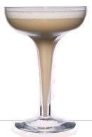
THE FLOATING PROCEDURE
Another technique which is similar to layering is to “float” an ingredient. This usually refers to the last ingredient to be added to a cocktail which will sit on top of the finished recipe as part of the garnish. Examples of this method are liqueur coffee recipes such as the Widow’s Dream or the Vodka Espresso.
Example is: Widow’s Dream
Ingredients:
1Measure Bénédictine Dom
1MeasureCream
1pc. Egg White
Method:
Shake the ingredients – except the cream – together with ice and pour into a cocktail glass. Then carefully float the cream on the top using the back of a spoon. No garnish.

Slide 57
OTHER TECHNIQUES
MUDDLING
Muddling is a bartending mixology term for crushing fruits or herbs to release their full flavor into a cocktail ­ in the same way a chef would use a pestle and mortar to prepare food ingredients. A muddler is not dissimilar to a rolling pin in that it has a flat end and is usually made of wood. Only use the muddling technique is the base of a shaker or sturdy glass ­ pushing down with a slight twist.
Good examples of cocktail recipes using this method are the Bene & Blend, the Mint Julep or the Mojito.

Slide 58
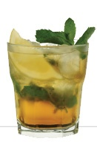
Important note: do not attempt to muddle unripe or hard fruit in a glass as the pressure needed may break the glass.
Example is: Béné & Blend
Ingredients:
1 Measure Bénédictine Dom
1 Measure Blended Whisky
1 Measure Sugar Syrup
Method:
Muddle the sugar syrup with some fresh mint leaves in the bottom of a tumbler glass. Half- fill the glass with ice cubes. Pour in the Bénédictine and the Whisky. Stir gently. Garnish with slice of lemon.

Slide 59
RIM A GLASS
Some cocktail recipes will call for a rimmed glass; rimming a glass adds a decorative touch and also additional flavor to cocktails.
Salt and sugar are the most common ingredients used to rimming glasses. Salt is used for most of drinks based on Tequila as one of the ingredients. Cocoa is also used.
The technique is about to moisten the rim of the glass, using juices, syrups or liqueurs depending on the taste of the drink. E.g.: sour taste goes well with lemon/lime, sweet taste goes well with coffee, chocolate or any other sweet liqueur. And then applying the glass on the selected dry ingredient. E.g.: Salt, Sugar which can be colored with food colorants, Cocoa, Shredded Coconut, etc.

Slide 60
Moisten the glass
You can try either of the following techniques:
-Wet the outside rim of the glass with a fresh lemon or lime wedge, or
-Insert glass rim into a saucer or plate with the liquid agent: lemon, lime, or any other juice, syrup or liqueur.
Apply the dry ingredient
1. Fill a saucer or bowl with dry ingredient [salt, sugar, powdered nuts, etc.
2. Hold the glass parallel to the table.
3. Dab the rim into the dry ingredient while slowly turning the glass so that only the outer edge is covered.
4. Shake off any excess dry ingredient over a sink or wastebasket.
5. Fill the glass with your cocktail and garnish.
6. You may also get one of those glass rimmers, which is a bar accessory and it is used to apply the dry and liquid agents to the rim of the glasses.

Slide 61
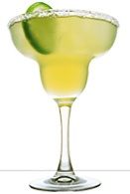
You may also get one of those glass rimmers, which is a bar accessory and it is used to apply the dry and liquid agents to the rim of the glasses.
Example is: Margarita
Ingredients:
2measures Tequila
1 measure Cointreau
0.5 Measure Lime Juice
Method:
Prepare the cocktail glass by rubbing lime juice all the way around the edge of the glass and place on a saucer of salt to achieve the salted rim effect. Then add the Tequila, Cointreau and lime juice into a cocktail shaker full of ice and shake well together. Strain into the cocktail glass or Martini glass. Traditionally served in a salt rimmed glass, you can also add a sliced wheel of fresh lime if desired.

Slide 62

FLAME A DRINK
Flaming a drink is a very attractive ritual of cocktail making.
* Warm the glass.
* Prepare your cocktail.
* Pour a bit of the highest proof alcohol into a spoon.
* Ignite using a long kitchen match.
* Carefully pour flaming liquid into the cocktail.
* Serve immediately.
* Extinguish before drinking.
It is important to remember:
* Use extreme caution.
* For a fabulous sparkle effect, carefully twist an orange rind over the flame.
And the most important:
Never drink while flame is still lit!!!

Slide 63
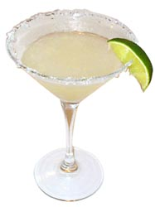
FROST A GLASS
In the cocktail world, there are actually
two ways to frost a glass:
1.For "Frosted Drinks", serving glasses are stored in the refrigerator or buried in shaved ice enough time to give glass a white, frosted ice cold look and feel.
2. For "Sugar/Salt Frosted": serving glasses are moistened on the rim with a slice of lemon or lime or dipped into the juices as well as in syrups according to the recipe instructions and then rim is dipped finally into powdered salt or sugar or any other powdery ingredient such as ground hazelnuts, etc. A typical example of this type of frosting is the glass for “Margaritas cocktail”, which is rub the rim with lime, invert glass and dip in coarse salt.

Slide 64
TIPS ON MIXING DRINKS
1. Use high quality ingredients. The quality of mixed drinks is dependent on the quality of ingredients.
2. Use plenty of crystal clear ice. Place them in mixing glass or in a shaker before adding liquor.
3. Always measure the ingredients in correct proportion so as not to spoil the drink and to insure consistency in quality and cost.
4. Strictly follow the procedure so as not to spoil the drink. Some drinks are shaken with ice for better dilution or to dissolve sugar and other heavy ingredients like egg white. Others are only stirred with ice.
5. Chill glass for chilled drinks and heat glasses for hot drinks.
6. Simple syrup must be prepared in advance. 1 part sugar and 1part water, boil until sugar is dissolved. Cool and pour into a covered container.

Slide 65
7. Mixers such as soda water, tonic water, ginger ale and fruit juice should be added to the liquor and not the opposite.
8. Always use the right glass for every drink.
9.Lemon or orange peel should be twisted over the drink only after the drink is finished.
10. If the recipe calls for an egg, either white or yolk, put the egg first so as not to spoil the spirit if the egg happens to be spoiled.
11. Clear mixtures should be stirred. Cloudy ones should be shaken.
12. When a recipe talks of a dash, this means a drop or two
13. Prepare fruit juices before use
14. Add sparkling liquid last
15. Use ice generously. Use cracked ice for shakers and lots of ice cubes for highball drinks.

Slide 66
Do's:
- In making good drink, use ice in big cubes of about 3cm in size.
- If making your own ice cubes in trays use filtered or bottled water which will then avoid the likelihood of a slight chlorine taste often found in tap water.
- Ice should be dry in texture and would feel almost sticky when you touch it.
- Use cracked ice in a blender for frozen drinks it creates the kind of effect without damaging your blender, whereas lumped cubes does not break down totally and could cause problems with the blender.
- Store your ice in a big ice well with a drain and make sure you drain it regularly.
- If you're going to be making a lot of recipes using crushed ice such as a Mojito, it is worth investing in an electric ice crusher instead of a hand cracked one. This will save time.

Slide 67
Don'ts:
- Don't use ice that has started to thaw.
- Never scoop the ice with your hands or an ice scoop made of glass.
- Never re-use ice that you have already shaken or stirred with not even if you are making another cocktail of the same recipe.
- Green olives go well with Martini, Pearl onion with a Gibson and Cherries with Manhattan
- Cherries can either float in the cocktail, or you can pierce them with a cocktail toothpick or wedge them on the rim of the glass.
- Prepare all necessary ingredients and bar supplies ready before mixing
- Specific requests such as the following are important and must be honored.

Slide 68
Request Meaning
Neat - No ice
On the rocks - In a shallow glass with ice
Straight up - In a cocktail glass with no ice
With a twist - A twist of Lemon
No fruit - No garnish
Very dry - With very little Vermouth
A squeeze of lime - Self-explanatory

Slide 69
TRADE SECRETS
Although bartenders have the same standard operational procedures to follow, they generally differ in ways, styles, techniques in promoting and remaining a higher standard of service to the customer.
1. Checking Glasses – soap always leave a dull film, use instead either plain hot water or a cleaner made just for glassware. When polishing, hold up against the lights. It is the best way to check for print/dust/spot or films left on the glass surface and also guarantee to impress a watching customer with your thoroughness.
2. Cleaning the Bar Back Mirror – little amount of lemon juice or ammonia mixed with warm water will remove streaks and films laid down by dust particles and cigarette smoke. Use paper towel to dry and polish mirror so it will not collect lint.

Slide 70
3. Always Use Fresh Fruits for Garnishes – cut lemons, lime and orange early in the day or way before operation start, then refrigerate to keep freshness intact. In the evening left-over is best covered with damp cloth or napkin before storing inside the fridge to keep freshness in and spoilage out.
4. Always Wash the Fruits Before Cutting – in lemon and orange peel for drinks, do not forget to remove bitter white under skin.
5. To get the most juice out of fresh lemon and orange: prepare warm water in a container, soak unpack fruit for a few seconds, remove and roll it back and forth on counter top or cutting board by pushing it.
6. To maintain a crispy celery stalk and leaves, soak it upside down in a glass of cold water then refrigerate for a couple of days. For a quicker result do the same but fill the glass with lots of ice.

Slide 71
7. Lemon Sour Mix – can be made in advanced or instantly; mix 3 parts of fresh lemon juice to one part of simple syrup, then add one egg white for every 25 ounces of juice and syrup mix.
8. Remember: The way to make a drink is the way the customer like it. Customer is always right even if the drink he orders is made entirely of different ingredients for either ways.
9. Measure all the drinks correctly – this is done to ensure the same or uniform taste all the time. Always use a few drops extra, rather than a few less drop.
10. When pouring to a jigger – hold jigger over the glass, and then pour liquor: spillage if any will just go right into the glass.

Slide 72
11. When mixing several cocktails – line up all glasses, put ice then pour the desired liquor base, mixer and special agents can be added next.
12. Before pouring – always check every glass for possible cracks, chips, dull films and other unsightly marks that the customer may notice as the drink is emptied.
13. Shake cocktail briskly – but do not do it for too long. Do not give ice time to make the drink watery. Just shake till drink is cold enough or when frost forms outside the metal shaker.
14. When customer order liquor by brand name – place bottles on the bar in front of him before pouring or mixing the drink. This simple gesture can go along way in pleasing the customer.

Slide 73
15. When pouring from a bottle, hold it firmly in the middle and always with the label facing toward the customer.
16. Do not try to save money or ingredients at the customer expense. Good liquor makes a good drink. Many bartenders assume that customers can’t tell the difference. True, some cannot, but many more can. So NEVER take a chance.
17. If more than one drink is poured from the same shaker – line up all the glasses on the bar with rims touching, then run the shaker back and forth over the row of glasses. Fill all of them part way first before completely filling up each glass equally. This is to ensure that everybody gets a fair amount.

Slide 74
18. Chill all glasses for iced drinks – there are several ways to chill a glass. One is to fill it with shaved ice; another is to bury it in shaved ice. You can put ice and water into the glass swirl it constantly, otherwise, let it stand in the freezer compartment for a few minutes. To heat a glass, fill it with hot or boiling water and let it stand a minute or two then empty.
Be sure to use a dry and sturdy glass to avoid breakage/s.

